Slide 1


Determining Strategic Priorities
Shared Tenets of Workforce Partners
11-7-2016
Town and Country Hotel, San Diego

Slide 2
How did we get here?
Notes:
How did we get here?
Remind of 45M in funds between (STRONG Workforce, WDBs)
3 years ago – lets do shared labor market data
Lets plan together, not separate
September 21st priorities the following tenets

Slide 3
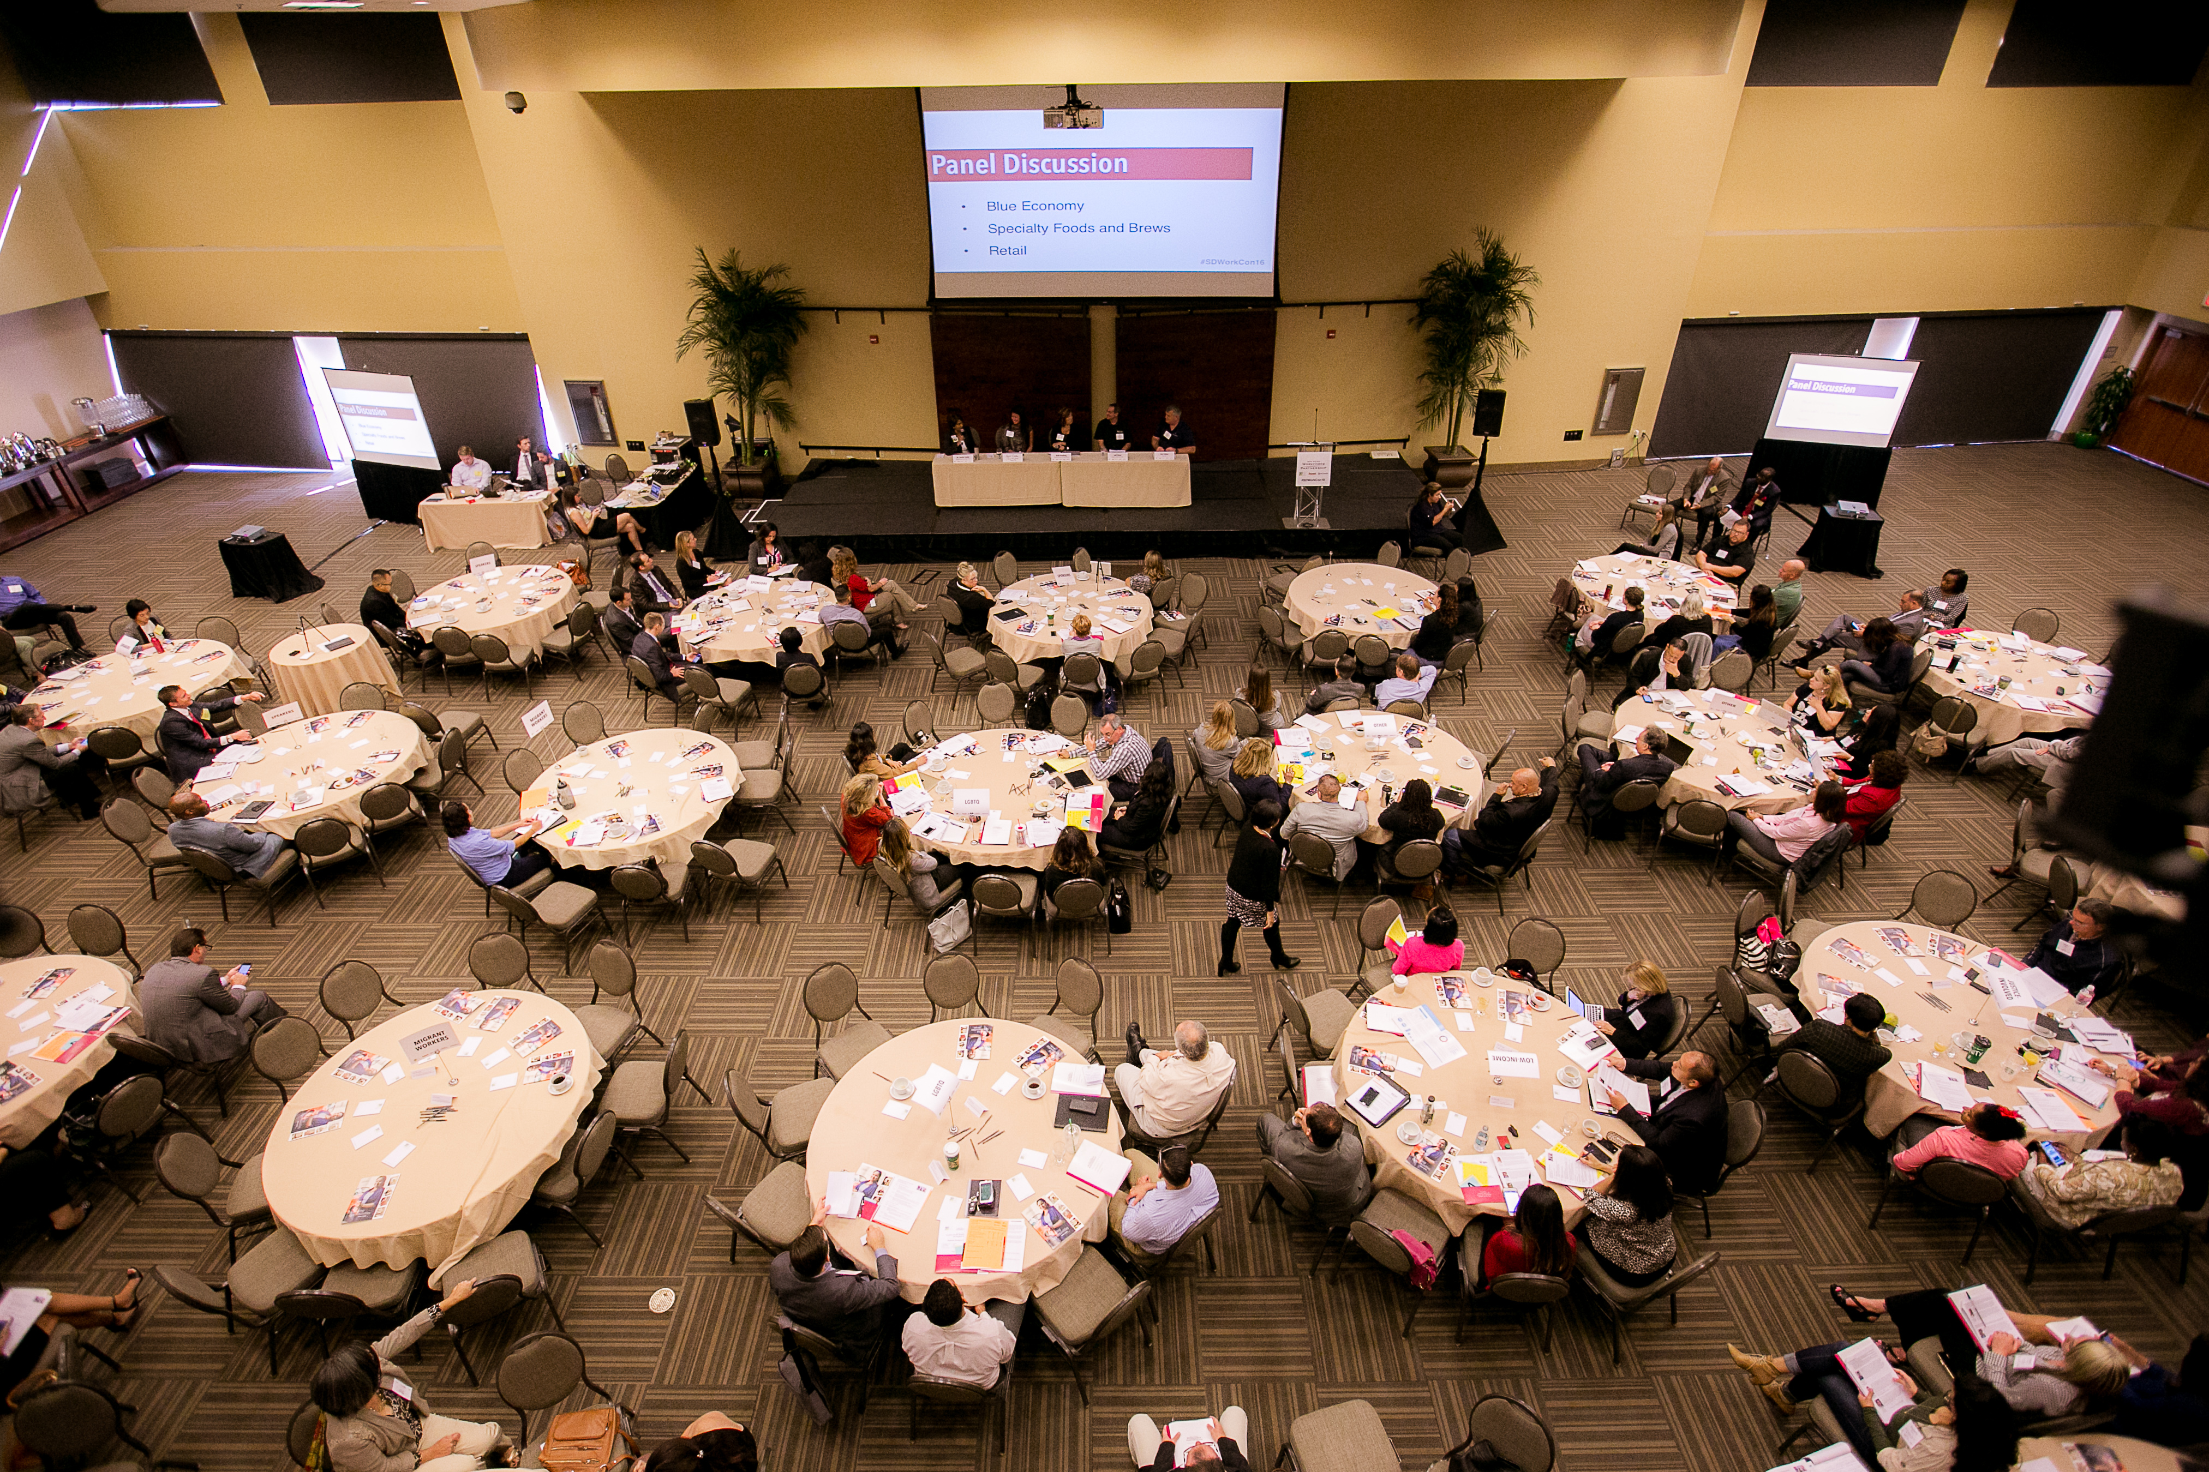

Slide 4
1. Coordinated industry engagement & single entry point for business customers

Slide 5




Slide 6
2. Demand—driven skills attainment and doing our part for 1M “middle-skill” certs

Slide 7

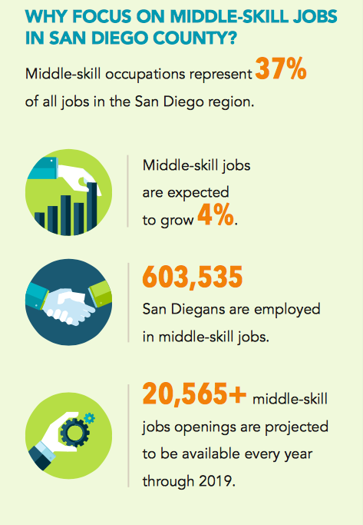

Slide 8
3. Evidenced Based Decision Making & Shared Labor Market Research

Slide 9


Slide 10
4. Regional Workforce System is more than the programs we fund

Slide 11
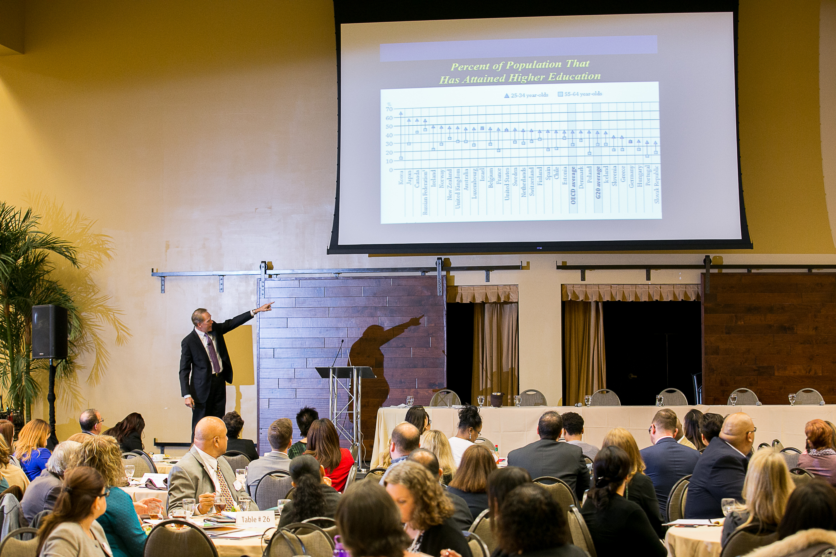

Slide 12
5. Creating opportunity and career paths for all.

Slide 13

Notes:
Malcom

Slide 14
6. Shared services, braided funding, and co-located infrastructure

Slide 15


Slide 16
7. Human-centered approach to service design.

Slide 17




Slide 18
8. Increase access to education, training and employment services

Slide 20
9. Common definition of work readiness

Slide 21


Slide 22
10. Develop action plan to keep each partner accountable

