Slide 1
San Diego Imperial Regional Pathway Mapping Project
8/24/2018

Slide 2
Occupation(s)
Postsecondary Path(s)
High School Path

Slide 3
Data Collection – K12 Pathway Dataset
Outreach to 22 Districts/Agencies
Conducted 14 Interviews
Collected Course Information from 7 Districts
Identifying lead informants for Imperial Districts
Compilation into Single Database
11 Districts, 5 with complete course data
72 High Schools
14 sectors and 49 Unique Pathways

Slide 4
Data Elements (Interviews & Supplemental Data)
Descriptor for Each Pathway at Each School
Courses Within each pathway or program
Course sequencing (Perkins)
Course Articulation or Dual Enrollment Status
Certification
Industry Certification
Course A to G Status
PTLW, LL, or CPA Status
Enrollment
Work Based Learning
Employer Engagement

Slide 5
Course Fields: 914 currently coded
County, District, School, Sector, Pathway Descriptor
Course Descriptor, Sequence, Articulation, A-G Eligibility

Slide 6
Course Counts by Pathway

Slide 7
Articulated Course Counts by Pathway

Slide 8
Next Phase: Data Analysis
Comparative – K12 : CC : Occupations
Volume and Throughput Impacts
Geographic Distribution and Access
Gaps and Opportunities

Slide 9
CDE Sectors | Community College Sectors | Occupation Codes
Agriculture Natural Resources | Advanced Manufacturing | Management Occupations
Arts Media and Entertainment | Advanced Transp Logistics | Business and Finance Operations
Building and construction | Agriculture, Water, Env Tech | Computer & Math Occupations
Business and Finance | Business and Entrepreneurship | Architecture Engineering Occup’s
Education, Child Dev, Fam Svs | Energy Construction Utilities | Comm & Social Services
Energy, Env, Utilities | Global Trade | Legal Occupations
Engineering and Architecture | Health | Healthcare Practitioners
Fashion and Interior Des | Information Comm Technology | Healthcare Support Occupations
Health Science Med Tech | Life Sciences Biotechnology | Protective Service Occupations
Hospitality Tourism | Retail, Hosp, Tourism | Food Preparation and Serving
Information Comm Tech |  | Personal Care and Service
Manufacturing Prod Dev |  | Office and Administrative Suppt
Marketing Sales Service |  | Construction and Extraction
Public Services |  | Installation, Maint, & Repair
Transportation |  | Production Occupations

Slide 11
Visualizations: Throughput

Slide 12
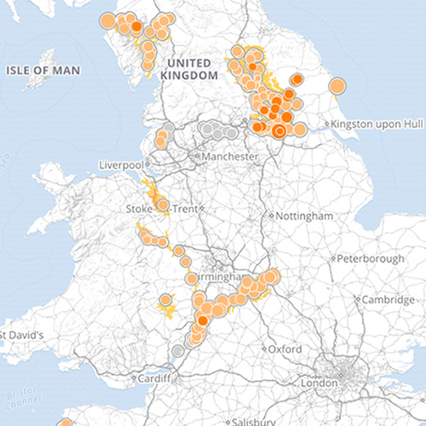
Visualizations: Mapping

Slide 13
Considerations for Analysis & Tool Development
Consumers
How Introduced and Where is the Information Used
What Level & Complexity of Data To Present
Difficulty in Development and Maintenance

Slide 14
Pathway Team
Randy Tillery: rtiller@wested.org
Allie Bollella: abollel@wested.org
Jimi Gilroy: jgilroy@wested.org

