Slide 1
Priority & Emerging Sectors: Middle-Skill Job Market
Tina Ngo Bartel
Center of Excellence for Labor Market Research

Slide 2
About the COE
The Centers of Excellence for Labor Market Research are the number one source of labor market information for the California community colleges.

Slide 3
114 colleges, 9 COEs
coeccc.net/contact
Sara Phillips
Far North Counties
Aaron Wilcher North Far North
Laura Coleman Statewide Director
Nora Seronello Central
John Carrese Bay
Michael Goss Inland Empire/Desert
Adele Hermann South Central Coast
Lori Sanchez LA-Orange
Tina Ngo Bartel San Diego-Imperial
Jesse Crete
Orange County

Slide 4
Objectives for today
Understand the importance of the middle-skill job market
Discuss the need to market the Priority & Emerging Sectors and their in-demand (top) jobs
Explore strategies to navigate programs and careers

Slide 5
“increase by at least 20% the number of CCC students annually who acquire associate degrees, credentials, certificates, or specific skill sets that prepare them for an in-demand job”

Slide 6
COE Product: Regional Scans

Slide 7
Jobs Breakdown in San Diego County, 2017
1.5M Jobs
Source: Emsi. Job classifications defined by COE
Notes:
Military and unclassified jobs were removed This is based on employer responses/surveys as to how many jobs there are in the market

Slide 8
Above-middle-skill vs. middle-skill job market
Source: Emsi. Graph by COE

Slide 9
Have opportunities for economic mobility
*
$15.99
*The Self-Sufficiency Standard is the hourly wage ($15.99) that a single adult (with no family) needs to earn to meet basic needs in San Diego County. selfsufficiencystandard.org

Slide 10
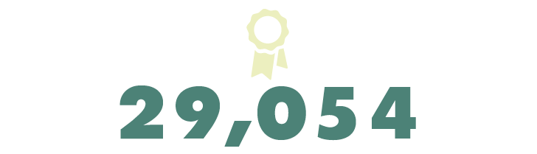
45,457
16,403
Demand
Supply
Gap

Slide 11
I have a list of occupations. Now what?

Slide 12
COE Product: Sector Analyses
Draft

Slide 13
7 Priority & Emerging Sectors
Agriculture, Water, & Environmental Technologies
Advanced Transportation & Logistics
Advanced Manufacturing
Business & Entrepreneurship
Energy, Construction, & Utilities
Global Trade
Health
ICT & Digital Media
Life Sciences & Biotechnology

Slide 14
An in-demand job does not equal enrollments

Slide 15
What is labor market demand and supply?
Labor market demand = average annual job openings between 2017 and 2022
Labor market supply = average annual awards (certificates, degrees) between 2015 and 2017
Excludes programs that do not receive financial aid (e.g., nonprofit programs)

Slide 16
SOC-TOP-CIP crosswalk and code alignment
SOC code = occupational code
TOP code = community college program code
CIP code = non-community college code
SOC
TOP
CIP

Slide 17
Where are the gaps/opportunities?
*043000: Biotechnology and Biomedical Technology train for these occupations

Slide 18
One TOP code trains for 4 top middle-skill jobs
043000: Biotechnology and Biomedical Technology

Slide 19
Why are the supply numbers so low?
Notes:
Why don’t we just create another program to increase supply?

Slide 20
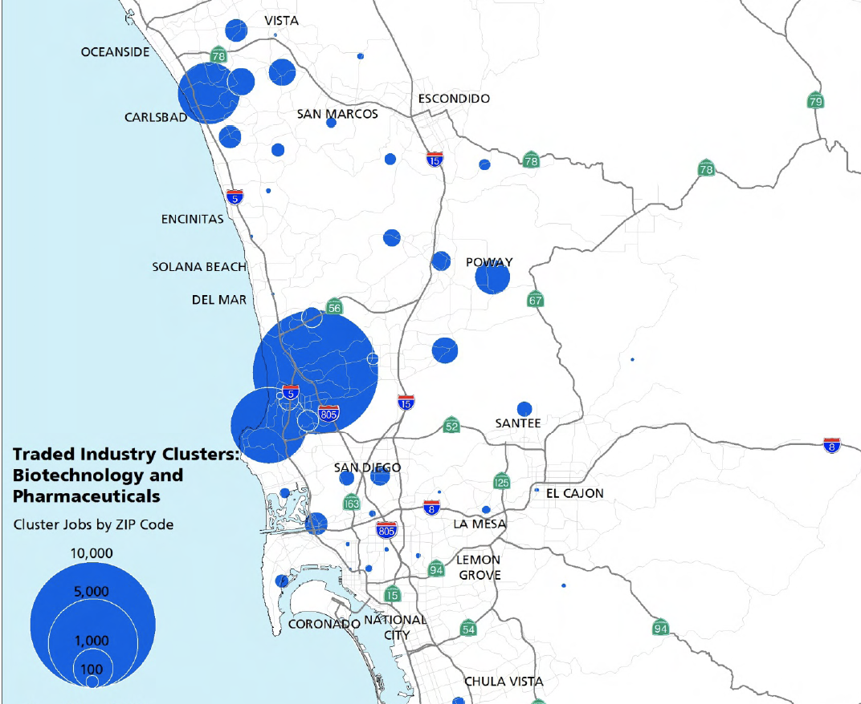

Slide 21
Guided marketing to help navigate 350+ job types
Notes:
https://www.10news.com/news/making-it-in-san-diego/making-it-in-san-diego-biotech-industry-is-booming-hiring-and-attainable-for-anyone

Slide 22
CareerEd.org

Slide 23
Targeted sectors and in-demand jobs

Slide 26
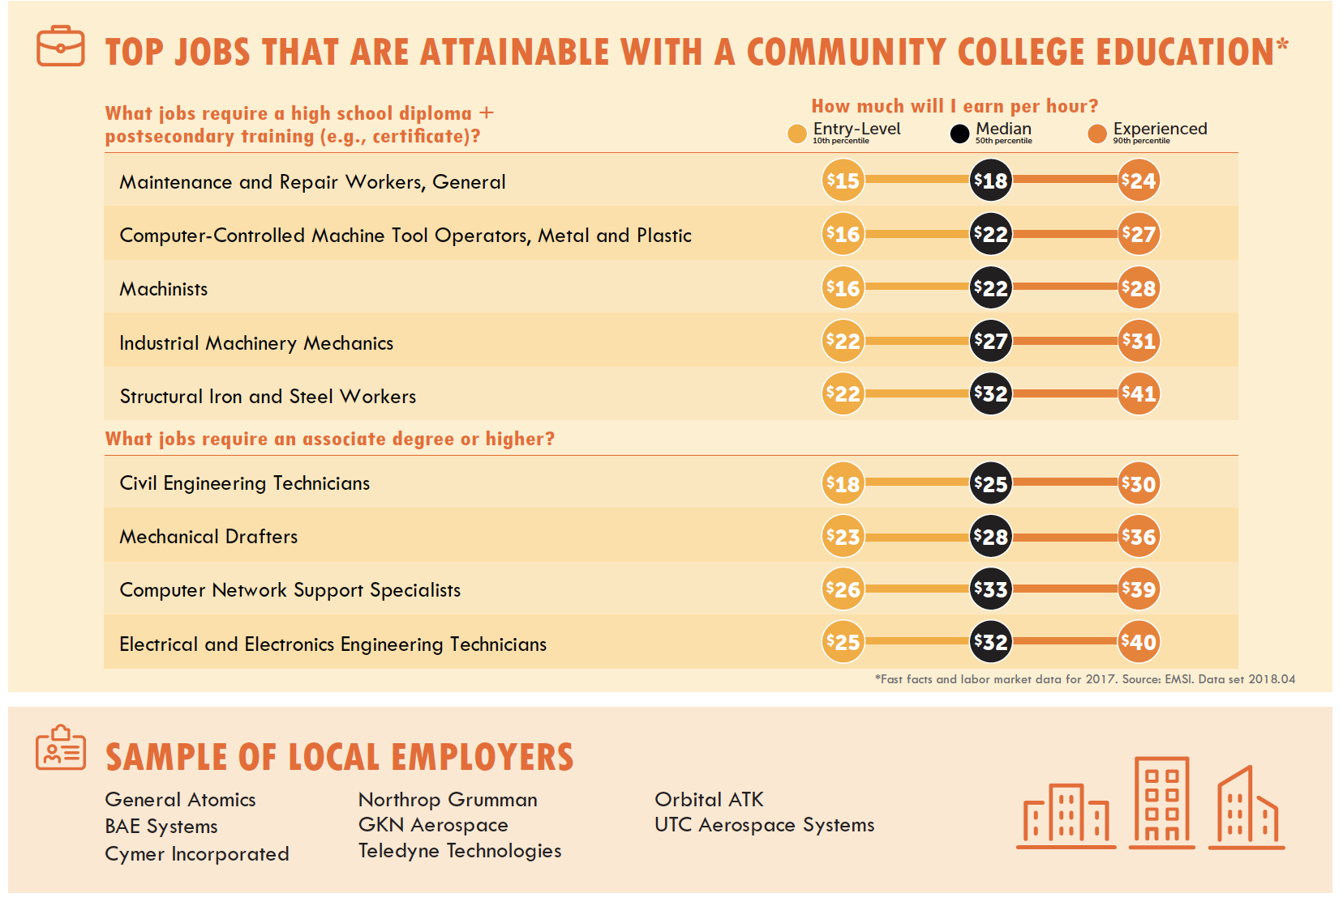

Slide 27
Recommendations for LS & other sectors
Regional marketing campaign:
Careers to students
Programs to incumbent workers
Cost benefit / solution to turnover to employers
Employer engagement:
Assist with hiring practices: AA/AS vs. BA/BS
Internships or work-based learning opportunities

Slide 29
Where are the gaps/opportunities?
Notes:
This sector provides a lot of opportunity for self-sufficiency

Slide 31
Depending on the occupation, languages vary
 | Sites That Use It
JAVA | Netflix Edmunds Zappos
NET / C # | Exact Target Comcast XBOX
PHP | Facebook Tumblr Wikipedia
NODE.js | PayPal Walmart Yahoo
 | Sites That Use It
C | Bloomberg Windows OS Apache
C++ | JPMorgan Chase DIRECTV Sony
Python | USA Today Google YouTube
RUBY | Twitter Ask.fm GitHub
entrepreneur.com/article/241644
Notes:
https://www.entrepreneur.com/article/241644

Slide 32
Top ICT certifications in 2014
Cisco Certified Networking Associate
CompTIA A+
CompTIA Security+
CompTIA Network+
Microsoft Certified Solutions Expert – Business Intelligence
Microsoft Certified Solutions Associate – SQL
Microsoft Technology Associate – Database
Microsoft Technology Associate – Networking
Microsoft Windows Server 2012
San Diego Workforce Partnership. ICT: Labor Market Analysis. 2014.

Slide 33
Top ICT certifications in 2017
Project Management Professional (PMP)
CompTIA Security+
IT Infrastructure Library (ITIL) Certification
Certified Information Systems Security Professional (CISSP)
Cisco Certified Network Associate (CCNA)
Certified A+ Technician
Cisco Certified Network Professional (CCNP)
CompTIA Network+
Burning Glass. Online Job Postings. 2017.

Slide 34
Top ICT certifications in 2018
Certified in the Government Enterprise IT (CGEIT)
AWE Certified Solutions Architect – Associate
Project Management Professional (PMP)
Certified Information Systems Security Professional (CISSP)
Certified in Risk and Information Systems Control (CRISC)
Certified Information Security Manager (CISM)
Certified ScrumMaster
Certified Ethical Hacker (CEH)
CIO.com. The 15 most valuable IT certifications today. 2018.
Notes:
https://www.cio.com/article/2392856/it-skills-training/careers-staffing-12-it-certifications-that-deliver-career-advancement.html

Slide 35
Challenges
There is no shortage of ICT & Digital Media programs/certificates in the region
Navigating through existing programs can be extremely difficult
ICT programs have the highest enrollments, but low retention and completion numbers

Slide 36
Start with the end (career) in mind
First ask yourself…
What occupation am I interested in?

Slide 37
Type in key words (occupation) in the search bar
workforce.emsicc.com

Slide 38
Search by key word(s) like you would in O*NET

Slide 39
See if the job description and tasks are interesting

Slide 40
Understand what kind of education is required

Slide 41
Click on links to live online job postings

Slide 43
Ask for an informational interview

Slide 44
Key Takeaways
Expose students early to in-demand jobs in our Priority & Emerging Sectors
Begin with the end (career) in mind to help students navigate the various course/program offerings in the region and online

Slide 46
LMI provides recs to regional workgroups
Data & Research (Labor Market Information)
Marketing
Career Pathways
MS/HS Engagement
Pathway Navigation
Work-based Learning and Job Placement
Tutoring
Employer Engagement and Deputy Sector Navigators (DSNs)

Slide 47
Thank you!
tngobartel@miracosta.edu

