Slide 1
Strong Workforce Program
Preliminary Regional Results for
Applied and Work-Based
Learning Surveys
December 7, 2018
DRAFT

Slide 2
Agenda
Assessment Purpose
Methodology
Regional Responses
Purposes for Applied/WBL
Opportunities
Challenges
Supports and Professional Development Interests
Recommendations & Next Steps

Slide 3
Purpose of the Surveys
Establish overall status of WBL at the campuses
Examine quality features to inform professional development and improvement
Identify challenges to inform systemic reforms
Identify needs for support
Identify requests for professional development to inform offerings
Response goal: enough responses to inform WBL system development

Slide 4
Purpose of the Inventory
Establish baseline data at each college, for the college as a whole and/or in key target areas for growth
Support planning for next steps in WBL expansion efforts

Slide 5
Applied/ Work-Based Learning Surveys
Surveys collect information on:
Types of applied and work-based learning offered
Ways that colleges and faculty implement WBL and job placement
Challenges faced
Requests for support and professional development
2 versions of this survey – a faculty survey and a college perspective survey

Slide 6
Methodology
Surveys developed by WG 4
Single Point of Contact at each college led the effort to collect data for 4 surveys
Applied and WBL Faculty Survey
Applied and WBL College Perspective
Applied and WBL Inventory
21st Century Skills
3 week window to collect as much data as possible from each college
Notes:
Remind them that College Perspective is – experts at the college (list roles)
Role:
Career Center director/coordinator
curriculum chairperson
counselor who could provide the best perspective on WBL at the college
cooperative work experience director/coordinator
other key roles such as the director of experiential education

Slide 7
Regional Responses for Applied and Work-Based Learning Surveys

Slide 8
Purposes for WBL as a Teaching Strategy
College Perspective
Faculty
Notes:
RESPONDENTS TO BOTH SURVEYS AGREE TO BOTH PURPOSES
Emerging theme from open ended analysis:
“Provides content for resume, applications, and interviews”
the purposes with the highest percentage of responses from the College Perspective respondents include:
Helps students clarify their career goals (77%)
Brings relevance to curriculum – helps students understand why they need to learn something (74%)
Prepares students for the world of work (provides exposure to workplace culture and practices) (74%)
And, the purposes with the highest percentage of responses from Faculty Survey respondents include:
Brings relevance to curriculum – helps students understand why they need to learn something (71%)
Helps students learn skills that are best learned through application (65%)
Prepares students for the world of work (provides exposure to workplace culture and practices) (61%)

Slide 9
Opportunities Offered
Career Assessment & Planning
WBL: Career Awareness & Exploration
WBL: Career Preparation & Training

Slide 10
Career Assessment & Planning
100% of colleges in the region offer:
Career assessments or reflective exercises
Opportunities for students to talk with a counselor or staff member who has career guidance training
Career awareness and exploration class
Development of a format “education plan” that incorporates career options or goals based on prior career education
Resume writing
Interview skills training (e.g., mock interviews)
90% of colleges in the region offer:
Written or electronic based tools that describe various careers
Pathways or multimedia tools that describe various careers
Notes:
CP DATA
For a coherent snapshot of the college perspective related to each opportunity, responses for college perspective items related to types of opportunities offered were combined for each college

Slide 11
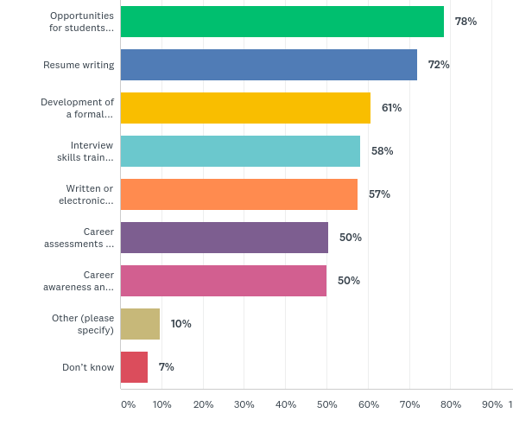
Types of career assessment, planning, or job readiness activities available at your college?
Faculty Responses:
Top 3 Responses for Faculty
& College Perspective:
Opportunities for students to talk with counselor for career guidance
Resume writing
Development of a formal “education plan” incorporating career options or goals based on prior career exploration
Notes:
Three top three responses - faculty and CP agree on for most frequently offered but CP has several others that are also 100% - see slide 11

Slide 12
Work-based Learning Continuum
Notes:
The summary of the applied and work-based learning opportunities data is divided into the following two sections (which represent the first half and second half of the Work-Based Learning Continuum):
Opportunities for Applied and Work-Based Learning: Career Awareness and Exploration
Opportunities for Applied and Work-Based Learning: Career Preparation and Training

Slide 13
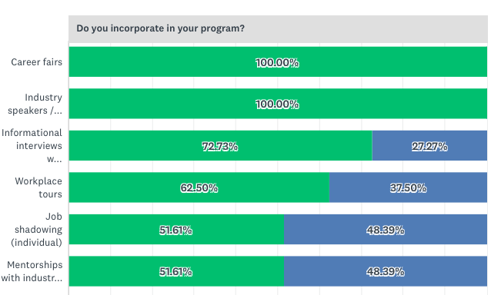
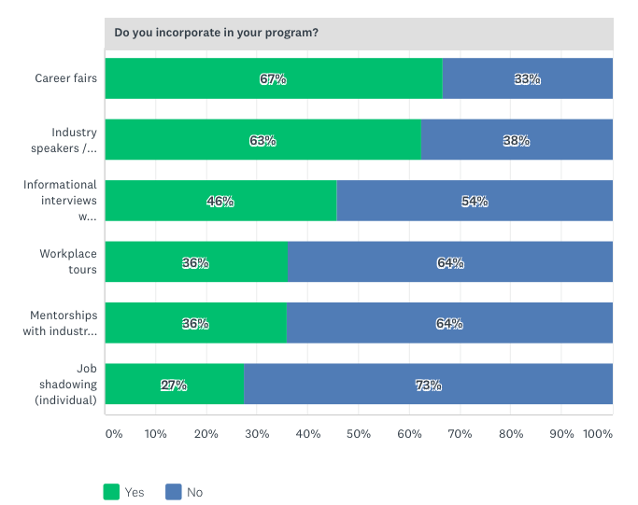
WBL: Career Awareness and Exploration Opportunities Offered
College Perspective
Faculty
Career fairs
Industry speakers/presentations
Informational interviews with industry pros.
Workplace tours
Notes:
Respondents to the College Perspective Survey and Faculty Survey agreed that the most frequently offered opportunities are the following:
Career fairs
Industry speakers/presentation
Informational interviews with industry professionals
Workplace tours

Slide 14
WBL: Career Awareness and Exploration Primary broker/facilitator of opportunities
College Perspective:
Career center brokers all opportunities
Students facilitate their own Job Shadowing
Faculty:
Career center brokers career fairs
Faculty broker all other opportunities
Notes:
Faculty Survey respondents indicated that the Career Center is only the most frequent broker for Career Fairs and that all other opportunities are most frequently facilitated by individual faculty for their own class.
College Perspective Survey respondents indicated that the Career Center is the most frequent primary broker for the following opportunities:
Industry speakers/presentations
Career fairs
Informational interviews with industry professionals
Workplace tours
Mentorships with industry professionals
Caveat
Note: The results from these two surveys may differ due to the survey samples. The College Perspective Survey data includes a more representative sample than the Faculty Survey because it was a targeted survey sent to a few key staff at each college and includes 1 to 5 responses from each of the colleges (with the exception of MiraCosta which has 8 responses because the survey was sent to a broader representative of staff). The Faculty Survey received responses from only a small percentage of the total population of faculty at the 10 colleges; therefore, we cannot infer that all faculty in the region agree that these opportunities are brokered in these ways.

Slide 15
WBL: Career Preparation and Training Opportunities Offered
100% of colleges in the region offer
Classroom projects with industry involvement
Internships (unpaid)
Internships (paid)
Clinical experiences required by regulatory agencies (e.g., in nursing)
Jobs
90% of colleges in the region offer
Service learning
Cooperative work experience education
Volunteering/community service
Simulated workplace experience
80% of colleges in the region offer
Apprenticeships
70% of colleges in the region offer
Student-run commercial or social enterprises
On-the-job training
Notes:
CP DATA

Slide 16
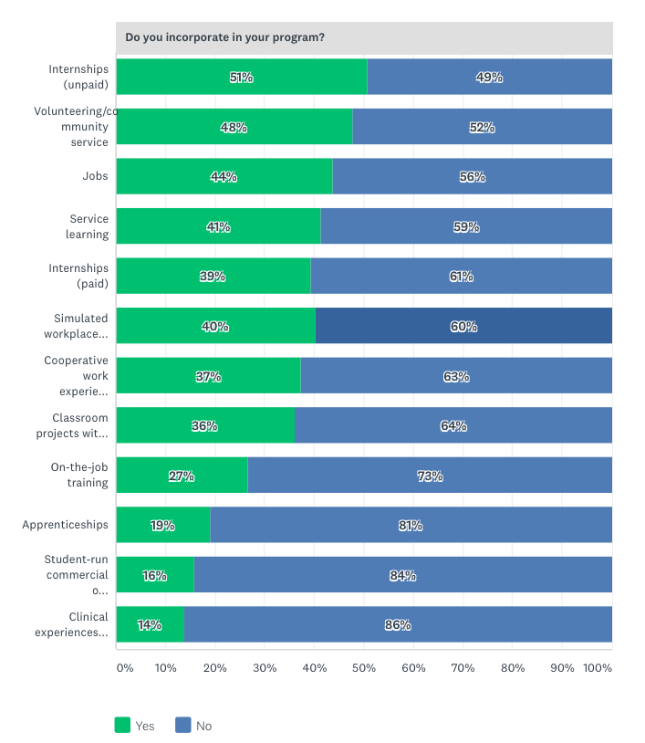
WBL: Career Preparation and Training Opportunities Offered
Faculty:
Top Responses for College Perspective & Faculty:
Internships (unpaid)
Volunteering/community service
Jobs
Service Learning
Internships (paid)
Simulated workplace experience

Slide 17
WBL: Career Preparation & Training Primary broker/facilitator of opportunities
Career preparation and training opportunities are most often brokered by:
Career Center
Department/faculty facilitate for entire program/department
Individual faculty facilitating for their own class
Notes:
CP and Faculty agreed on these 3 as the top brokers. The notes could included the list of the 6 options:
Career center staff facilitate
Department/faculty facilitate for the entire department/program
Individual faculty facilitate for their own class
Special program staff facilitate (e.g., Puente)
Existing WBL coordinator facilitates
Employment office facilitates
Students find opportunities on their own

Slide 18
Challenges to Applied/WBL & Job Placement

Slide 19
Challenges to Implementing Applied & WBL
Most frequently reported challenges:
Students’ need to work for their livelihoods, making it difficult to take unpaid or temporary internships
100% of College Perspective Survey respondents reported this as a challenge (38% reported very challenging)
98% of Faculty Survey respondents reported this as a challenge (48% reported very challenging)
Lack of paid intensive workplace learning opportunities (such as paid internships)
100% of College Perspective Survey respondents reported this as a challenge (31% reported very challenging)
89% of Faculty Survey respondents reported this as a challenge (37% reported very challenging)
Students’ overall lack of time for any extra experiences
94% of College Perspective Survey respondents reported this as a challenge (25% reported very challenging)
95% of Faculty Survey respondents reported this as a challenge (32% reported very challenging)
Notes:
Most frequent 6 out of 11- split between 2 slides.
EDIT THIS - TWO VERSIONS (handouts vs presentation)
Lack of paid intensive workplace learning opportunities (such as paid internships)
100% of College Perspective Survey respondents reported this as a challenge (31% reported very challenging)
89% of Faculty Survey respondents reported this as a challenge (37% reported very challenging)
Students’ need to work for their livelihoods, making it difficult to take unpaid or temporary internships
100% of College Perspective Survey respondents reported this as a challenge (38% reported very challenging)
98% of Faculty Survey respondents reported this as a challenge (48% reported very challenging)
Students’ overall lack of time for any extra experiences
94% of College Perspective Survey respondents reported this as a challenge (25% reported very challenging)
95% of Faculty Survey respondents reported this as a challenge (32% reported very challenging)

Slide 20
Challenges to Implementing Applied & WBL (continued) Most frequently reported challenges:
Time required to engage employers and coordinate student placements
91% of College Perspective Survey respondents reported this as a challenge (25% reported very challenging)
90% of Faculty Survey respondents reported this as a challenge (31% reported very challenging)
Lack of student preparedness and required skills
91% of College Perspective Survey respondents reported this as a challenge (6% reported very challenging)
86% of Faculty Survey respondents reported this as a challenge (13% reported very challenging)
Lack of staff to broker opportunities
87% of College Perspective Survey respondents reported this as a challenge (34% reported very challenging)
90% of Faculty Survey respondents reported this as a challenge (31% reported very challenging)
Notes:
Main finding – CP and Faculty have similar view on this
The other answer choices were also listed as challenges by a large percentage of respondents. The only challenge that was reported by fewer than 75% of respondents was:
Insurance and liability issues
28% of College Perspective Survey respondents indicated that this is not a challenge at all (but 72% indicated that it is)
35% of Faculty Survey respondents indicated that this is not a challenge at all (but 65% indicated that it is)

Slide 21
Challenges to Implementing Applied & WBL (continued) Additional emerging themes (from analysis of open-ended responses)
Marketing and communication challenges
Students need to understand the importance of WBL as it relates to career preparation
Language as consideration in career preparation and WBL
Lack of professional space for meetings with employers
“Marketing opportunities to students; most often we market through each program's faculty.”
“Making it explicit how what I teach is related to what workforce wants.”

Slide 22
Challenges Related to Job Placement Most frequently reported challenges:
Lack of staff time for case management
CP = 38% very challenging
Faculty = 32% very challenging
Students already working
Students lack resources (e.g., clothing, transportation, child care, etc.)
Students need knowledge of industry culture
Students need knowledge of workplace practices (e.g., how organizations and interviews work)
Students need improved interview skills
Students need improved writing skills for application and resumes
Notes:
Edit the bullets, fewer words – to get idea across (handout vs. presented)
+++++++
Most frequently reported challenges: OF 20 responses
The challenges cited by 100% of College Perspective Survey respondents and 87-97% of Faculty Survey respondents include:
[KERRY – SHOULD THIS BE A SEPARATE SLIDE?]
In addition to the challenges listed in the survey, the following challenges emerged in our content analysis of relevant open response items:
Students need to recognize the importance of career preparation and understand the time and effort it takes to find a meaningful job
Lack of Institutional support
Students need certificates or degrees required by employers
9% of College Perspective Survey respondents indicated that this is not a challenge at all (but 91% indicated that it is)
23% of Faculty Survey respondents indicated that this is not a challenge at all (but 77% indicated that it is)
Students need portfolios or other demonstrable evidence of competence
9% of College Perspective Survey respondents indicated that this is not a challenge at all (but 91% indicated that it is)
19% of Faculty Survey respondents indicated that this is not a challenge at all (but 81% indicated that it is)
Students need improved English skills
13% of College Perspective Survey respondents indicated that this is not a challenge at all (but 87% indicated that it is)
14% of Faculty Survey respondents indicated that this is not a challenge at all (but 86% indicated that it is)

Slide 23
Challenges to Job Placement (continued) Additional emerging themes (from analysis of open-ended responses)
Students need to recognize the importance of career preparation and understand the time and effort it takes to find a meaningful job
Lack of Institutional support
“The challenge is convincing students that this knowledge and experience will make them more successful.”
“The campus culture isn't in tune with the idea of WBL. It needs to be embedded in how we orient our students and staff/faculty.”
Notes:
students don’t always understands the time and effort involved in the job seeking process + institutional support

Slide 24
Supports and Professional Development Needed

Slide 25
Support Needed: To expand/improve Applied & WBL
College Perspective Survey and Faculty Survey respondents agreed:
All 6 types of supports are needed
The top 2 support needs are:
Support for preparing students for experiences
79% of College Perspective Survey respondents reported this as a support needed
65% of Faculty Survey respondents reported this as a support needed
Support for placement of students
79% of College Perspective Survey respondents reported this as a support needed
68% of Faculty Survey respondents reported this as a support needed
Notes:
67-79% of College Perspective Survey respondents and 58-68% of Faculty Survey respondents) agreed that the 6 types of applied and WBL supports listed in the surveys are needed.
LIST OF ALL 6
Access to a searchable list of opportunities (listed by sector or other criteria)
Support for preparing students for experiences
Support for placement of students
Support for curriculum integration and transfer of learning
Support for monitoring student progress
Support for student assessment or employer feedback

Slide 26
Supports Needed for Applied & WBL Additional emerging themes (from analysis of open-ended responses)
Marketing and communication to students so they understand the importance of WBL as it relates to career preparation
Employer engagement to support work-based learning
Time and staff to teach job readiness skills
Institutional support and collaboration
Language support for ELLs
Need for data collection and tracking
“Workshops regarding job-readiness skills have been offered regularly…but few instructors support their students' attendance at such opportunities…”
“Need to institutionalize Work Based Learning activities from staffing, resources, database, marketing to students and faculty, etc.”
Notes:
Quotes from respondents

Slide 27
Support Needed: To expand/improve Job Placement
College Perspective Survey and Faculty Survey respondents agreed:
All 8 types of supports are needed
The top 3 support needs are:
Work with faculty to ensure that students are adequately prepared with language and writing skills
Work with WBL Coordinators to ensure that students have prior exposure to and experience in industries and workplaces of interest
Work with faculty to ensure students prepared with technical and other workplace skills and knowledge
Notes:
It is interesting to note that these 3 most frequently selected supports are related to working directly with faculty in some way. Respondents appear to want to work more closely with faculty to help ensure students have exposure to industries and are adequately prepared.
Work with faculty to ensure that students are adequately prepared with language and writing skill
75% of College Perspective Survey respondents reported this as a support needed
60% of Faculty Survey respondents reported this as a support needed
Work with WBL Coordinators to ensure that students have prior exposure to and experience in industries and workplaces of interest
75% of College Perspective Survey respondents reported this as a support needed
61% of Faculty Survey respondents reported this as a support needed
Work with faculty to ensure students prepared with technical and other workplace skills and knowledge
74% of College Perspective Survey respondents reported this as a support needed
58.24% of Faculty Survey respondents reported this as a support needed

Slide 28
Supports Needed for Job Placement Additional emerging themes (from analysis of open-ended responses)
Institutional support and collaboration
Employer engagement to support job placement
Marketing and communication to students about career preparation services
Language support for ELLs
Transportation support
“More collaboration between faculty and Student Employment services.”
“I'd like more support/ability to get the career center and professionals into my classroom to assist with job seeking skills.”
Notes:
Quotes from respondents

Slide 29
Professional Development Interests
College Perspective & Faculty
High percent of both indicated interests in all 5 types of PD
79-97% college perspective
80-93% faculty
Professional development opportunities:
Services and resources to support job placement
Services and resources to support WBL
Opportunity to hear about best practices
Work with peers working in the same industry sector to embed WBL into curriculum
Experience WBL first hand, through a faculty job shadow or internship

Slide 30
Professional Development Interests
Additional emerging themes (from analysis of open-ended responses)
Employer engagement and sector information
Incentivize participation in professional development opportunities
Technology
Delivery of professional development
Notes:
In addition to the themes included as answer choices in the survey, a few new professional development interests emerged in our content analysis of related open response items.
Below is a list of these interests and sample quotes from the surveys.

Slide 31
Employer Engagement

Slide 32
Employer Engagement: Current Support
College Perspective
Students reach out to employers on their own
Career center staff facilitate outreach
Department/faculty facilitate for the entire department/program
Existing coordinator facilitates outreach
Special program staff facilitate outreach
Deputy Sector Navigators (DSNs) facilitate outreach by sector
Work through an outside organization such as a local nonprofit organization
Employment office facilitates outreach
Other
Work through the Workforce Board
Notes:
EE supports listed currently exist at the colleges to some degree but that CP and Faculty respondents agreed on the 3 most frequently offered:
Students reach out to employers on their own
Career center facilitate outreach
Department/faculty facilitate their own department/program

Slide 33
Employer Engagement: Current Support
College Perspective
Faculty
Top 3 Responses:
Students reach out to employers on their own (67%)
Career center facilitates outreach (64%)
Department/faculty facilitate their own department/program (58%)
Top 3 Responses:
Career center facilitates outreach (55%)
Students reach out to employers on their own (49%)
Department/faculty facilitate their own department/program (47%)
Notes:
There were 9 in total
% are: e.g., 67% of respondents selected this answer choice (question was a “select all that apply”)
CP and Faculty agree on the 3 just 1 and 2 in different order.
College Perspective Survey respondents and Faculty Survey respondents agreed on the following 3 most frequently offered employment engagement supports:
Students reach out to employers on their own
Career center facilitate outreach
Department/faculty facilitate their own department/program
And, they also agreed that “work through the Workforce Board” was the least often used support. (Only 12% of College Perspective Survey respondents and 9% of Faculty Survey respondents indicated this option).
In addition to the types of employer engagement supports listed in the survey, “faculty facilitate for their students” emerged as another support type in our content analysis of related open response items.

Slide 34
Goals and Ideas for Expanding or Improving Applied & WBL
Increase awareness about applied and WBL opportunities (communication and technology)
Increase the number and types of applied and WBL opportunities
Institutionalize and improve collaboration for more structure and support
Create curriculum and learning opportunities related to industry or employability skills
Incentivize students / help them see the relevance and importance
Increase professional development
Increase employer engagement
Improve data and tracking systems
Technology
English language support

Slide 35
Recommendations & Next Steps
Goal:
Use these survey data to institutionalize WBL practices across the region
Next Steps:
Onboarding for WBL Coordinators and Job Placement Case Managers (JPCMs)
Provide college level teams, including WBL Coordinators, JPCMs, and existing WBL staff from each college, data from all 4 surveys for review
Establish WBL Community of Practice (CoP) including teams from each campus
Convene WBL CoP to review regional and college data and conduct SWOT analysis for strategic planning

Slide 36
(Optional Slide to include) WBL Inventory: Number of opportunities offered in your program (2017-18) (117 programs reporting across the region – includes 9 of 10 colleges)

