Slide 1
SD/IMP Regional Website Strategy Pilot Final UX Recommendation
September 13, 2018

Slide 2
Contents
Themes + Observations
Strategic Vision
Imperatives for Success
User Testing
Recommended Sitemap
Initial User Flows + Wireframes
Technology Thought-Starters
Potential Timeline
Next Steps

Slide 3
Phase 1 Objectives
Create a system of consistent, user-centric, student-first experiences across multiple colleges in the SD/IMP region
Create a website strategy which the colleges can reference to their own sites to identify any optimizations to make​ to their own sites, both new and old
Organize and streamline a higher education website’s content structure to best match a series of user flows​
Foster consistency across multiple regional colleges for ease of multi-college students

Slide 4
Themes + Observations

Slide 5
Theme 1 | The Philosophy
THEME: A global, omnipresent student-first approach is priority number one.
OBSERVATION: A flat, unclear hierarchy directed to an internal audience (faculty/staff) creates a poor user experience for the primary audience (prospective and current students), leading to confusion and choice overload, making it difficult for users to make a decision when faced with so many options that do not apply to them.
RECOMMENDATION: Build a website navigation that meets the overarching student-first philosophy and specifically targets the primary audience (prospective and current students).

Slide 6
Theme 2 | The Nuts and Bolts
THEME: Tightly bound with choice overload, content overload – sometimes dense, wordy, duplicate content, and other times disparate and sparse content – intimidates users.
OBSERVATION: Currently, faculty/staff have a significant level of input into the types and frequencies of content, often driven by status quo rather than data, and without adherence to guidelines and governance.
RECOMMENDATION: Consider these websites principally as marketing tools to include specific and relevant information for primary audiences (prospective and current students), and secondarily as an online library of resources to satisfy internal audience (faculty/staff) needs. Additionally, it’s important to note that users won’t consume content just because we put it out there; a main goal is to reduce redundancies and duplication and aim for in a nice balance that allows multiple entry points per audience.

Slide 7
Theme 3 | The Structure
THEME: If the homepage is your digital storefront, consider the navigation your main menu – it’s the most prime real estate that sets the tone for your website.
OBSERVATION: What is shown as the main navigation caters to internal audiences (faculty/staff) and its nomenclature is unclear; instead, what should be the main navigation is actually hidden within the collapsed hamburger menu. As internal audiences will know where to find things day after day, prospective students will not; and, as they are a primary audience, it’s crucial that they have clear paths to relevant content and actions.
RECOMMENDATION: Create clear paths based on what is most relevant to each audience, which gets them where they need to go, chiefly: about the college, admissions and aid, academics, student services, resources, student portal.

Slide 8
Theme 4 | The Maintenance
THEME: An easy-to-use CMS, coupled with consistent guidelines and governance, will significantly improve the day-to-day operations of the website.
OBSERVATION: The lack of a basic CMS with a templated/modular system makes it nearly impossible for content authors to update content or create net new pages in a timely manner, within the approved guidelines. This inevitably creates havoc, resulting in a patchwork of inconsistent architecture, content, tone and visuals.
RECOMMENDATION: Construct, implement, and maintain rock-solid governance, to include roles and responsibilities, user permissions, workflows, approval processes as well as clear guidelines for brand, content and CMS.

Slide 9
Strategic Vision

Slide 10
What does student-first mean?
It’s a steadfast philosophy, a foundational truth, a central theme that ties together the SD/IMP region of community colleges.
With this guiding light, we aim to build the ideal student experience.

Slide 11
Become a trusted source for student success by providing value for all audiences through a student-first, digital experience platform.

Slide 12
Build a reputation as a trusted source for:
Education and resources
Connected/integrated network
Customized choices and programs
Become a trusted source for student success by providing value for all audiences through a student-first, digital experience platform.

Slide 13
Prioritize student success by:
Guiding students to the right paths/careers
Streamlining access to priority programs
Providing resources to special audiences
Sharing relevant, up-to-date information
Enabling successful students to have successful careers
Become a trusted source for student success by providing value for all audiences through a student-first, digital experience platform.

Slide 14
Become a trusted source for student success by providing value for all audiences through a student-first, digital experience platform.
Provide value to different types of audiences:
Prospective students
High school
Returning
Adult
Continuing (non credit based)
Current students
First-time
Returning
Adult
Continuing (non credit based)
Community
Parents
Teachers
Counselors
Internal
Faculty
Staff
External
Employers
Donors
Media
Nonprofit organizations
Public servants

Slide 15
Become a trusted source for student success by providing value for all audiences through a student-first, digital experience platform.
Enable a digital experience platform featuring:
Optimized prospective and current student experience
Scalability with college and regional growth
Cohesive connection to regional digital ecosystem
All of the above, made possible by an easy-to-use Content Management System

Slide 16
Prioritize student success by:
Guiding students to the right paths/careers
Streamlining access to priority programs
Providing resources to special audiences
Sharing relevant, up-to-date information
Enabling successful students to have successful careers
Build a reputation as a trusted source for:
Education and resources
Connected/integrated network
Customized choices and programs
Become a trusted source for student success by providing value for all audiences through a student-first, digital experience platform.
Enable a digital experience platform featuring:
Optimized prospective and current student experience
Scalability with college and regional growth
Cohesive connection to regional digital ecosystem
All of the above, made possible by an easy-to-use Content Management System
Provide value to different types of audiences:
Prospective students
High school
Returning
Adult
Continuing (non credit based)
Current students
First-time
Returning
Adult
Continuing (non credit based)
Community
Parents
Teachers
Counselors
Internal
Faculty
Staff
External
Employers
Donors
Media
Nonprofit organizations
Public servants

Slide 17
Imperatives for Success

Slide 18
Architecture
Globally consistent navigation structure and nomenclature, consolidated into a focused hierarchy and utilized to organize content and get users to the right place
A series of different templates and column structures in order to differentiate utility from content and give content authors much more to work with when adding new content to the website
So, what exactly does this look like?
A sitemap structure for each college to use as a baseline to build from
Consistent terminology/nomenclature guidelines
A system of reusable UX/UI templates, driven by CMS structure

Slide 19
User experience
Responsive design, user experience and platform development
User-centric approach with clear paths that create transparency in the end-to-end website experience
Consistent, purposeful, high-contrast calls-to-action to direct the user to action
Variety of hero options to drive users to action, utilizing loop videos or striking images with specific messaging
So, what exactly does this look like?
Construction of user flows to illustrate detailed user experiences through the website
Template wireframes built to show layout and functionality; copywriters/developers to reference for new page development
Technical requirements document; developers to reference for development

Slide 20
Content
Reduction of redundant, duplicative content, in order to achieve a nice balance that allows multiple entry points per audience
Regularly updated content for target audiences and themes, with a streamlined approach to real-time publishing
Development of rich, evergreen content that can be repurposed on all channels, while also segmenting themes/topics (i.e., recruitment content is different from Guided Pathways content) and content types (i.e., headlines, CTAs, articles, blogs, images, infographics, illustrations) to drive organized, strategic development for distribution across other colleges and channels
Published guidelines and governance to define appropriate usage, promote consistency and create great user experiences as well as consistent content author workflows
So, what exactly does this look like?
A comprehensive content strategy to identify needs and opportunities, a plan for building and customizing content types for different audiences, and a roadmap that outlines the sequence and timing of content initiatives
An editorial calendar to outline relevant themes/topics, SEO keywords
Consistent content guidelines

Slide 21
Visual
Typography and iconography are extensions of a brand’s personality; use them in a consistent, relevant way that aid the navigation rather than clog up the user experience
Implement consistent design styles to help users find a visual hierarchy
Build a library of student-shot photography and assets styled to fit the college brand
So, what exactly does this look like?
Digital style guide; developers to reference for website development
Brand guidelines; all groups to reference for any design needs

Slide 22
Technology
Implement a fully supported/updated, stable, scalable, user-friendly Content Management System (CMS), that is universally easy-to-use
Utilize a strong global search functionality
Create a cohesive connection to the rest of the SD/IMP digital ecosystem (third party vendors, tools, social media)
So, what exactly does this look like?
Fully configured CMS infrastructure and front-facing website

Slide 23
User Testing

Slide 24
Why Test Our Sitemap?
TO GAIN INSIGHTS
Determine how easily users can find information, and exactly where they get lost
Confirm the nomenclature makes sense, or how to improve it based on common student language
TO VALIDATE OUR THINKING
Understand if content is grouped logically, or how to improve it
Validate the proposed Information Architecture structure and nomenclature

Slide 25
User Testing Objectives
We developed 10 questions focused on sitemap topics that aligned with key website objectives:
How do you apply to a community college?
How do you find programs at a community college?
As a student, how do I access important information about my college experience?
Increase applications
Convert prospective students
Get students where they need to go as fast as possible

Slide 26
User Testing Audience
412
21
18
Students + young adults
.edu*
Civilian team
Of the 512 people surveyed, we received 453 total completions.
At an 88% completion rate, our tree test results provide
an incredible wealth of data.
*Represented by: MiraCosta, SDSU, SDCCD, CSU Chico, GCCCD, SWCCD

Slide 27
Key Takeaways
Based on an individual success rate of over 75%, there are only a few topics that we should keep an eye on. These are perfect topics to test and iterate once the website is live.
Content clarity for prospective students vs current students
Content organization within Student Success vs Academics
Opportunity to push Career Planning content in strategic places
Academics to include information about online/continuing education vs Admissions + Aid to include specific direction for enrollment

Slide 28
Recommended Sitemap

Slide 29
Global Primary Navigation
Academics
Admissions + Aid
Campus Life
Homepage
Student Success
About

Slide 30
Global Secondary Navigation: Student Success
Student Success
Student Portal
Career Planning
Tutoring + Support
Library
Online Education Portal
Career Exploration
Student Services Directory
Math Learning Center
Writing Center

Slide 31
Global Secondary Navigation: Academics
Academics
Degree + Certificate Programs
Academic Calendar
Counseling
Online Education
Class Schedules + Catalog
Final Exam Schedule
Academic Counseling
Career Counseling
Continuing Education
Transfer Counseling
Notes:
Cous

Slide 32
Global Secondary Navigation: Admissions + Aid
Admissions + Aid
Class Registration
Scholarships
How to Apply
Requirements
Credit Classes
Online Education
Tuition + Fees
Class Schedules
Financial Aid
Continuing Education

Slide 33
Global Secondary Navigation: Campus Life
Campus Life
Support Services
News
Events
Events Detail
News Detail
LGBTQIA
Military + Veterans
Disabled
International
Athletics
Tickets
Food Pantry
Health Center
Clubs

Slide 34
Global Secondary Navigation: About
About
Jobs
Maps + Parking
Administration
Faculty/Staff
Request a Tour
Office of the President
Board of Trustees
Accreditation
History

Slide 35
Global Sticky Auxiliary + Utility Navigations
Sticky auxiliary navigation
For Prospective Students
For Current Students
For Faculty/Staff
Sticky utility navigation
Apply Now
Register for a Class
Student Portal
A-Z Index
Search

Slide 36
Global Footer
For Alumni
Alumni Association
Contact Us
For Compliance
Accessibility
Accreditation
Brown Act
Equal Opportunity Policy
FERPA
For Faculty/Staff
Employee Directory
Employee Portal
Quick Links
Apply Now
Bookstore
College Police
Crisis Resources
Maps + Parking
Register for a Class
Student Portal
Contact Us
Follow Us
Facebook
Instagram
LinkedIn
Twitter

Slide 37
Comprehensive Global Sitemap
Sticky auxiliary navigation
Academics
Admissions + Aid
Campus Life
Degree + Certificate Programs
Support Services
Homepage
Academic Calendar
Financial Aid
Events
Student Success
Student Portal
Library
Career Planning
About
Request a Tour
Counseling
Online Education Portal
Online Education
Jobs
Maps + Parking
Scholarships
News
How to Apply
Tutoring + Support
Administration
Faculty/Staff
Athletics
Class Schedules + Catalog
Class Registration
Tuition + Fees
History
Accreditation
Continuing Education
Clubs
For Prospective Students
For Current Students
For Faculty/Staff
Sticky utility navigation
Apply Now
Register for a Class
Student Portal
A-Z Index
Search

Slide 38
Initial User Flows + Wireframes

Slide 39
User Flow 1: Rebecca
18 year old high school senior, looking forward to graduating this spring
Exploring her options for colleges, programs and future careers, as she has not yet defined a clear path
Potential Student
Visits Site
Via Google Search, lands on default “For Prospective Students” homepage
Career Planning
Follows link from homepage
Explores Admissions
Reviews admission process and requirements
Investigates Programs
Learns about the specific programs and classes available to her
Applies
Reviews potential career paths and plans
Completes an online application
Exits site
Learns about fees

Slide 40
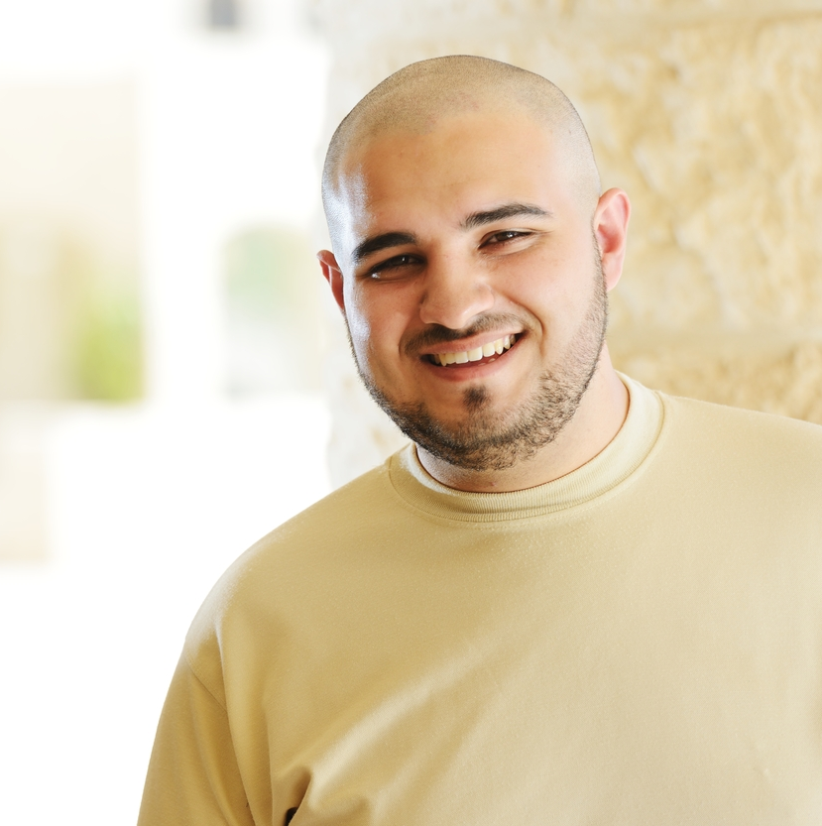
User Flow 2: Rob
27 year old student at Southwest Community College
Looking for a tutor to help him get through a chemistry program, and closer to his goal of becoming a Chemical Engineer
Current Student
Visits Site
Arrives on “For Current Students” homepage
Reviews Tutoring Options
Follows homepage links to Tutoring + Support page
Secures Tutoring
Exits site
Reviews tutoring opportunities and the available contact options

Slide 41
User Flow 3: Fletcher
42 year old Mathematics professor at San Diego City College
Wants to contact a fellow Mathematics professor to compare curriculum notes
Faculty/Staff
Visits Site
Lands on “For Faculty/Staff” homepage
Employee Portal
Follows link to the employee portal
Contacts Staff Member
Uses directory to find and contact desired employee
Exits site

Slide 42
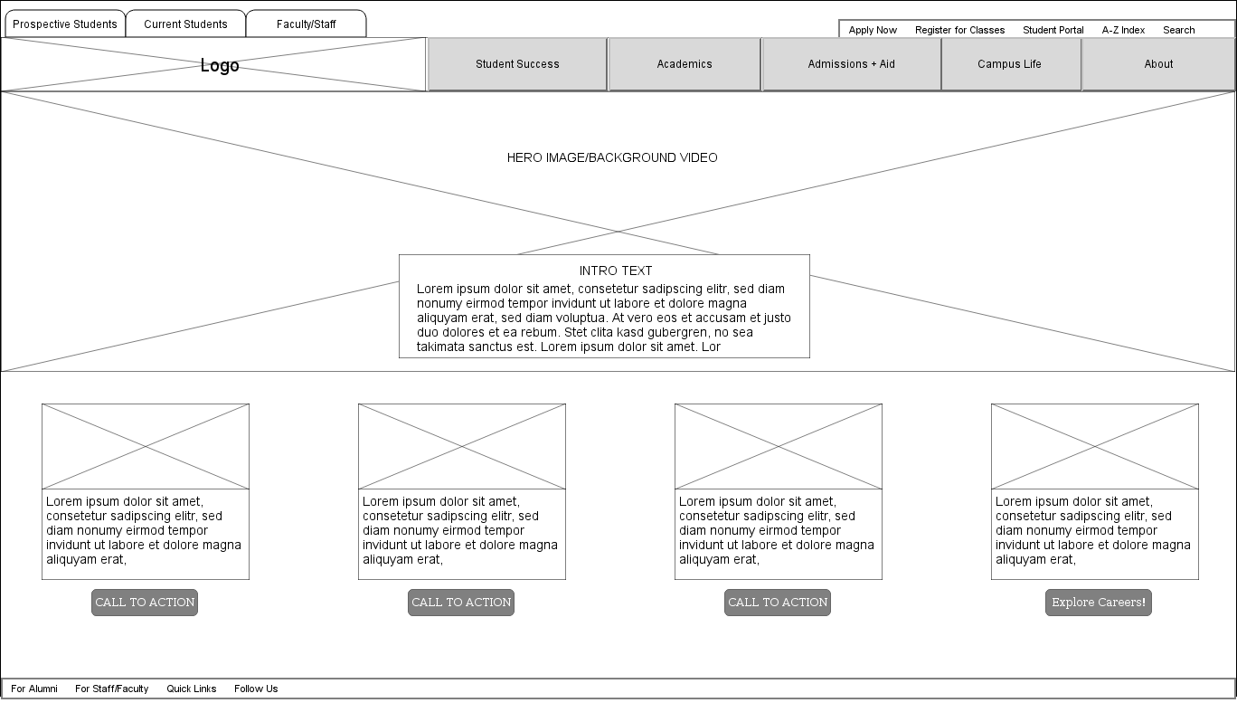
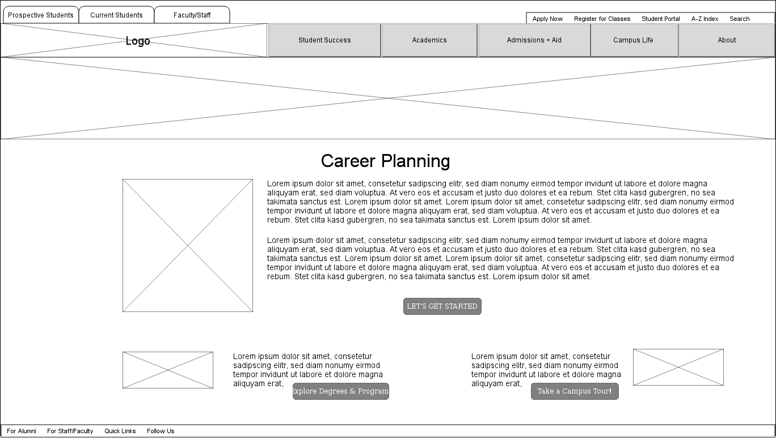
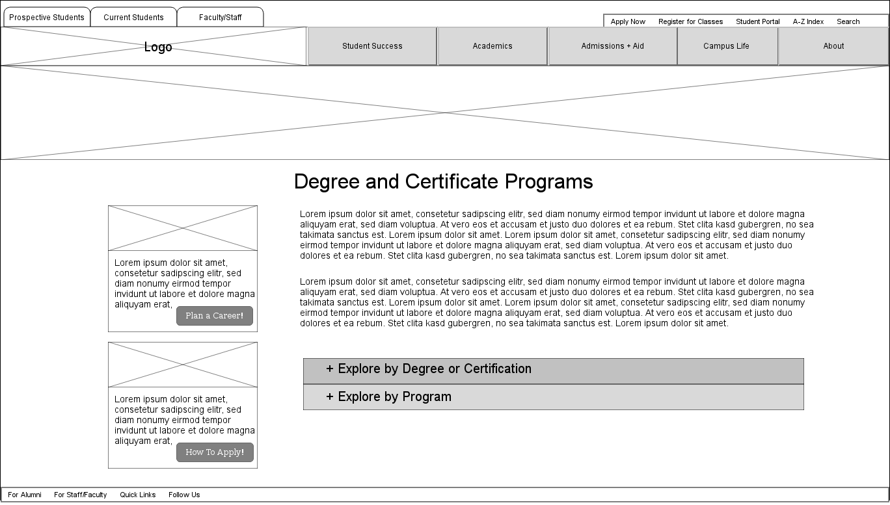
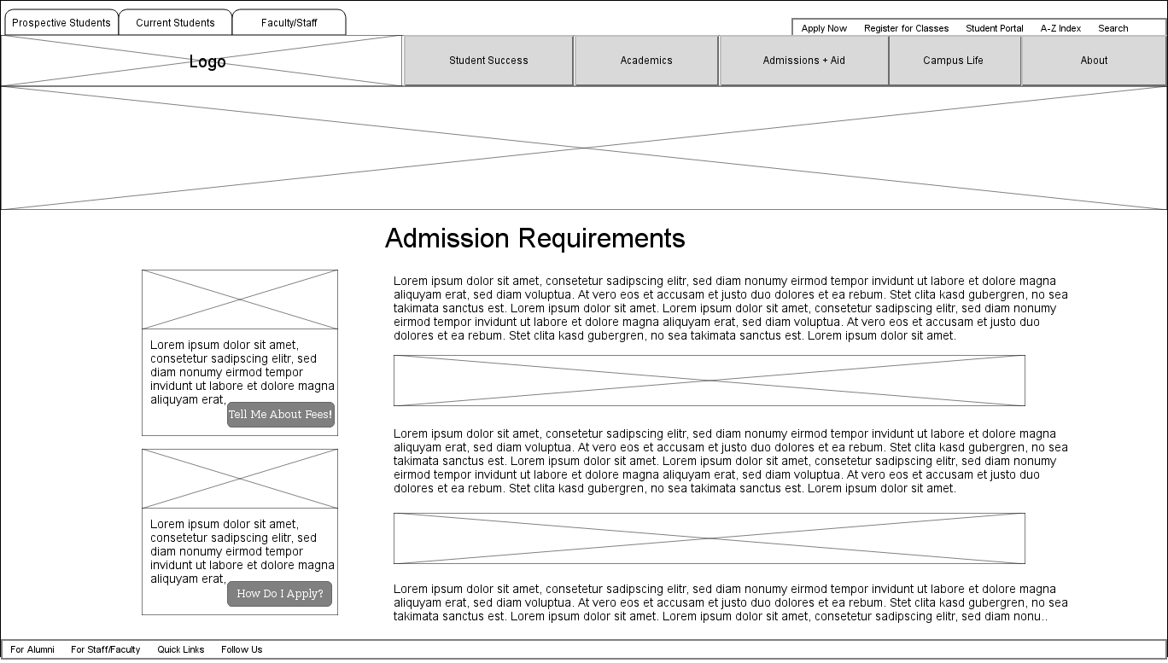
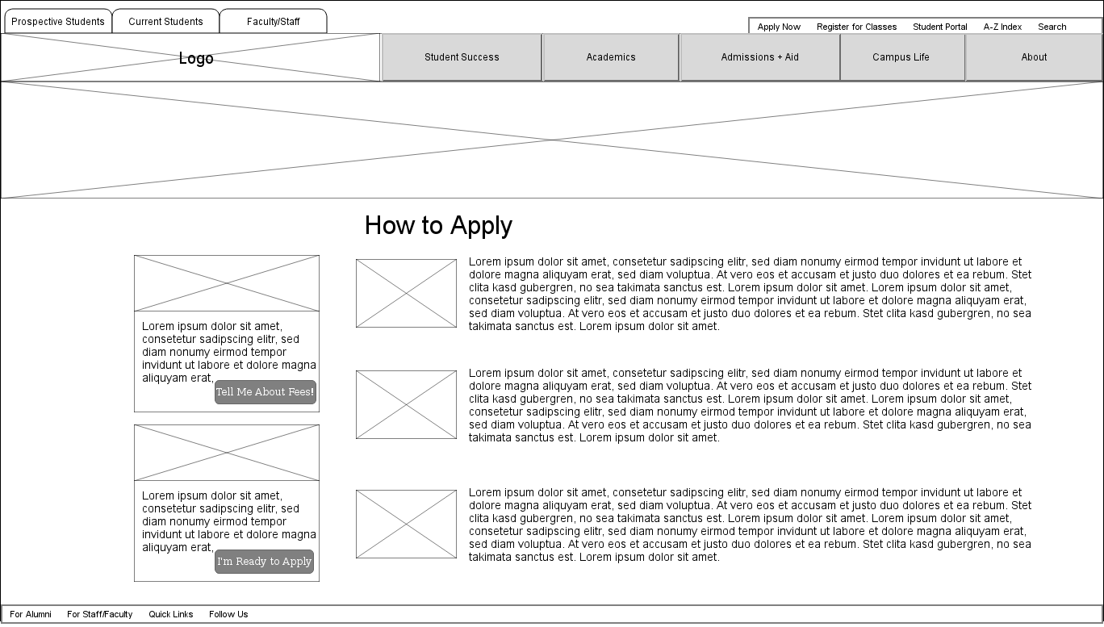
Wireframes – Screen Flow
1. Home
2. Career Planning
3. Degree + Certificate Programs
4. Admission Requirements
5. How to Apply

Slide 43
Wireframes | Home

Slide 44
Wireframes | Career Planning

Slide 45
Wireframes | Degree + Certificate Programs

Slide 46
Wireframes | Admission Requirements

Slide 47
Wireframes | How to Apply

Slide 48
Technology Recommendation

Slide 49
Technology Recommendation
During the phase 1 discovery, we learned of the need to implement a stable, scalable, easy-to-use Content Management System (CMS) platform that supports a new user experience and content approach across ~10 participating colleges within the SD/IMP region.
While each college website may have their own specific needs or heritage CMS, it’s critical to maintain a student-first approach and develop a consistent architecture, content strategy and look/feel across the region.
A huge benefit of this approach is the ability to use this platform as a tool to enable governance that will significantly improve and streamline the day-to-day operations of the college website – in this case, the website being the place the majority of users begin their college journey.

Slide 50
Technology Recommendation
We’re exploring CMS models and technologies that provide the following benefits:
Increased efficiencies - Content should be published easily and efficiently as editing and revisions should not require visual design or coding knowledge
Better SEO - Increase search engine ranking
Repeatable process - Workflow is a core feature of any good CMS; irrespective of how basic a workflow needs might be, workflows will ensure you maintain control over content
Security - As a SaaS based service
Scalability - Automatically scale to add websites, digital assets and manage traffic fluctuations with unlimited platform users
Support - Pick up the phone and reach support for simple to complex requests
Future proof - Content flexibility across a variety of platforms not limited to the website: Amazon Alexa, Mobile Apps, Video Games, VR Experience…

Slide 51
Potential Timeline

Slide 52
High-level Timeline

Slide 53
How We’ll Work Together
In order to execute a quality program and meet intended timelines, we’ll collaborate via:
Participation in frequent review meetings and brainstorms
Commitment to two rounds of reviews
Commitment to provide feedback within 2 business days
A single point of contact for each college website program, focused on:
Day to day program coordination and decision making
Consolidation and prioritization of stakeholder feedback
Arranging calls and meetings to review work-in-progress
Maintaining a sense of urgency to keep a consistent cadence

Slide 54
Next Steps

Slide 55
What Happens Next?
Initiate MiraCosta website execution – October 2018
Onboard Grossmont, Cuyamaca, Imperial Valley – January 2019
Confirm scope of work for remaining institutions – May 2019

