Slide 1
Strong Workforce Program
WBL and Job Placement
Assessment Training
October 8, 2018

Slide 2
Agenda
Introductions
Overview
Purpose of the Assessments
Description of the Assessments
Survey Administration Process
Inventory Administration Process
Timeline
Implementation Discussion
Questions

Slide 3
Introductions
San Diego/Imperial Counties Regional Consortium
WestEd
Single Point of Contact from each of the 10 colleges in the region

Slide 4
Overview
San Diego/Imperial Counties Strong Workforce Program (SWP)
The purpose of this project is to develop an infrastructure and processes for a regional system that will provide the colleges with programs and services to develop workplace and career skills, including employment readiness skills, and acquire employment upon completion of their program of study.
Notes:
7 workgroups with highlight on WG4 – this workgroup is conducting needs assessments to learn more about the ways work-based learning and job placement are being implemented at the 10 colleges and any needs for support.

Slide 5
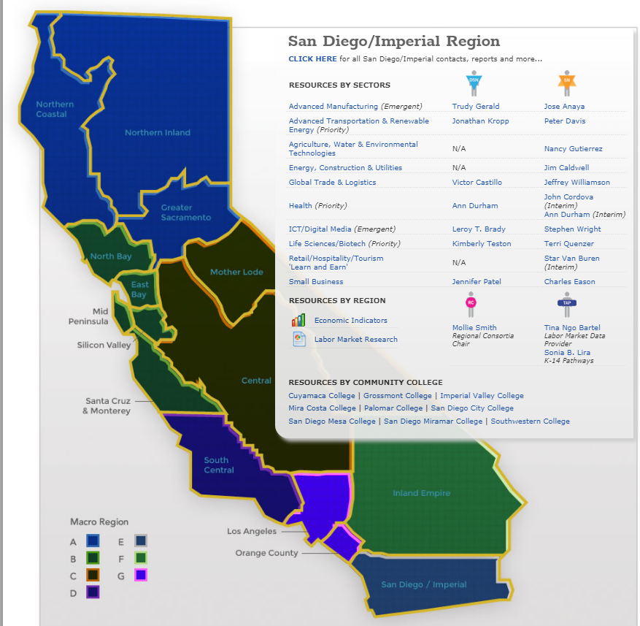
San Diego & Imperial Counties Regional Consortium
Regional economies: Sector approach
Advanced Manufacturing
Advanced Transportation & Logistics
Agriculture, Water & Environmental Technologies
Energy, Construction & Utilities
Global Trade
Health
Information & Communication Technologies (ICT)/Digital Media
Life Sciences/Biotech
Retail/Hospitality/Tourism
Small Business
Doing What Matters for Jobs and the Economy
2012

Slide 6
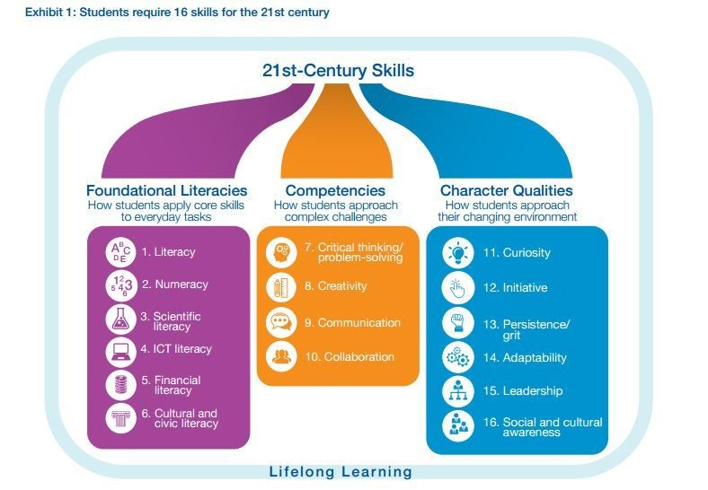
San Diego & Imperial Counties Regional Consortium
Education & the Economy
Poverty and Economic Mobility
State economic recovery: What jobs drive the economy?
Misalignment with the economy
Need for skilling, upskilling, reskilling
21st-Century Skills Employability Skills and Core Competencies
Notes:
WBL is the best way to align learning with the economy and develop core competencies.

Slide 7
Strong Workforce
Regional
Implementation

Slide 8
Notes:
HELP STUDENTS LEARN ON THE PATH
Program-specific learning outcomes
Project-based, collaborative learning
Applied learning experiences
Inescapable student engagement
Faculty-leg improvement of teaching practices
System/procedures for the college and students to track mastery of learning outcomes that lead to credentials, transfer and/or employment
(HAND OUT copy of WBL continuum to participants)

Slide 9
Regional Work Groups
Career Pathways
MS/HS Engagement
Pathway Navigation
WBL and Job Placement
Tutoring
Employer Engagement
Deputy Sector Navigators

Slide 10
Work-based Learning A continuum of experiences that support career awareness, career exploration, and career preparation, through engagement with employers and real work opportunities.
Notes:
Applied and work-based learning are critical strategies for deepening learning and preparing students for future career opportunities. Improved job placement services are also critical for many students seeking employment.
This WBL continuum shows the full range of learning opportunities, from career fairs and industry speakers to internships, paid co-operative work experience, clinical placements, and apprenticeships
Reference 21st Century Skills – In addition to preparing students for employment, Work-Based Learning also provides opportunities to teach the 21st Century Skills, which are difficult to teach out of context.
(HAND OUT copy of WBL continuum to participants)

Slide 11
21st Century Skills and Core Competencies
Adaptability Aesthetic awareness Collaboration Communication Creative thinking Critical thinking Cultural competence / Global awareness Education and career navigation skills Empathy Entrepreneurial mindset | Environmental awareness Ethical reasoning and action Information literacy / Digital fluency Leadership Learning skills and metacognition Personal responsibility / Self-management Problem-solving Resilience / Grit Self-awareness Social responsibility
Notes:
Each of the 10 community colleges in San Diego and Imperial Counties has identified core competencies that graduating students are expected to have mastered. The competencies cited as “core” vary only slightly from one institution to another and vary only slightly from the 21st century skills cited by universities and employers as critical to student success. The list of competencies/skills included in this survey is a combination of core competencies identified by the 10 community colleges in Region 10, the New World of Work, and the National Association of Colleges and Employers.

Slide 12
Strong Workforce Metrics and Leading Indicators
Number of WBL activities offered, by type of activity
Number of students accessing WBL, by type of WBL opportunity
Number of faculty attending WBL professional development

Slide 13
RFAs
Assessment Single Point of Contact
Work-Based Learning Coordinator
Job Placement Coordinator

Slide 14
Role of the Single Point of Contact
The role of the Single Point of Contact (SPC) identified by each of the 10 colleges is to oversee survey and inventory completion. SPCs (or staff they designate) are responsible for:
Making sure the surveys go out to all faculty and other key staff and following up as needed
Overseeing the completion of the Work-Based Learning and Job Placement Inventory
Notes:
This will involved engaging faculty and staff on campus to collect WBL participation data and, ideally, building relationships

Slide 15
Two Kinds of Assessments
Surveys
Inventory

Slide 16
Purpose of the Surveys
Identify needs for support
Examine quality features to inform professional development and improvement
Identify challenges to inform systemic reforms
Identify requests for professional development to inform offerings
Response goal = enough responses to get a handle on the issues/needs

Slide 17
Key Survey Features
One survey per college (WestEd will provide a unique link for each college)
No passcodes for individual respondents
SPC forwards link to identified respondents
Mostly closed-ended responses; little writing
WestEd receives survey responses
WestEd informs SPC of number of responses
SPC sends reminders as necessary
WestEd compiles data and makes it available to the field

Slide 18
Purpose of the Inventory
Collect baseline numbers to track leading indicators and enable monitoring of the expansion of WBL and Job Placements
Identify programs that want placement support (support roll-out of WBL and JP and planning for WBL Coordinator, JP Case Managers, and DSNs)
Facilitate the building of relationships with faculty to support future implementation
Response goal = comprehensive count
Notes:
WBL and JP as strategies to support better planning/decision making, better learning and engagement, more job placements, and more long term educational and career and success

Slide 19
Description of the Assessments: Online Surveys and Inventory
Applied and Work-Based Learning Faculty Survey
Applied and Work-Based Learning College Perspective Survey
Inventory of Applied and Work-Based Learning Opportunities Offered
21st Century Skills and Core Competencies Faculty Survey
Notes:
4 assessments

Slide 20
Applied and WBL Surveys
Survey collects information on:
the types of applied and work-based learning offered
ways that colleges and faculty implement WBL and job placement
challenges faced
needs for support
2 versions of this survey – a faculty survey and a college perspective survey

Slide 21
Faculty Survey
Intended for ALL instructional faculty (CE and academic)
Survey link sent via an email distribution list
Notes:
Instructional faculty = those teaching not running a program unless they do both
SPCs will need to work with their college to obtain an email distribution list that they can use to send the survey out to ALL faculty.

Slide 22
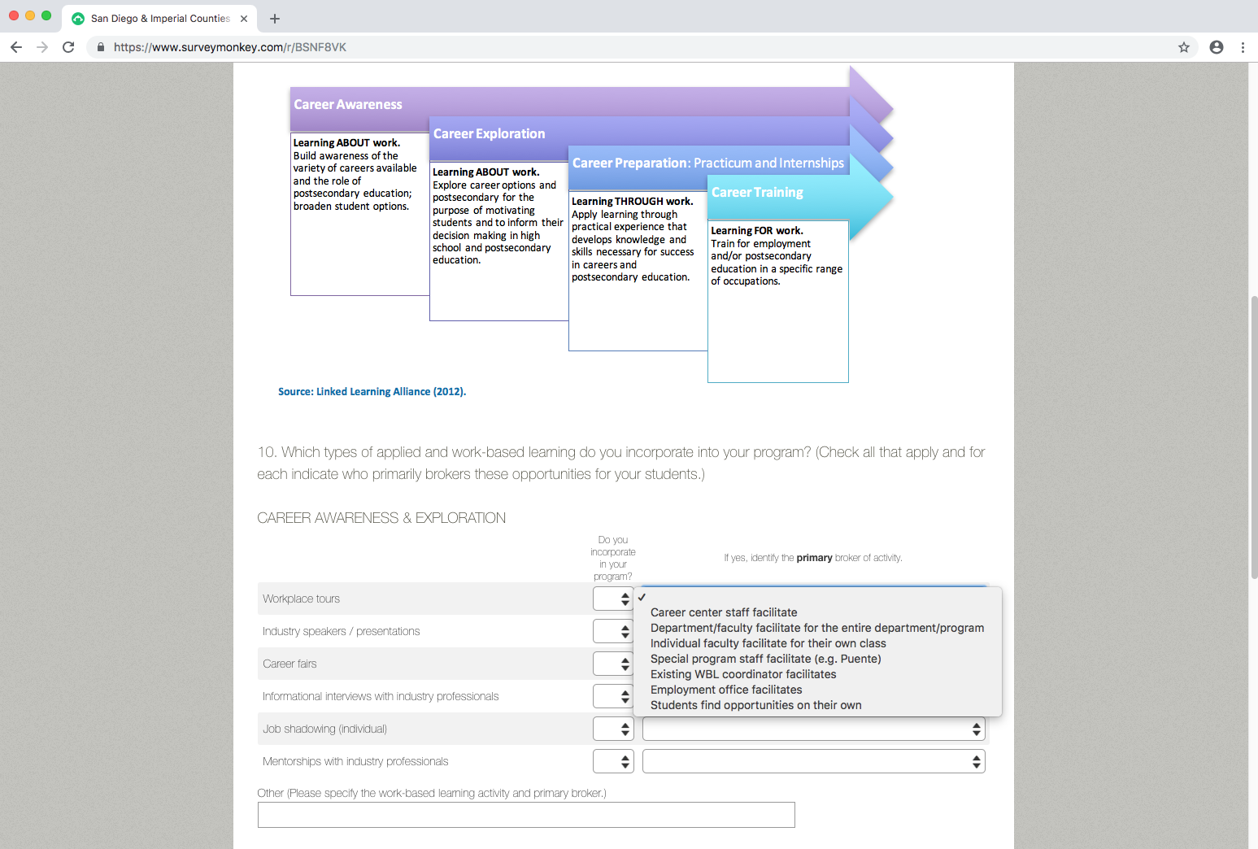

Slide 23
College Perspective Survey
Intended for a few representatives from each college who can provide a college perspective on applied and work-based learning at each college.
Career Center Director/Coordinator (or spokesperson for the Career Center)
Curriculum Chairperson
Counselor (one who can provide best perspective on WBL at the college)
Cooperative Work Experience Director/Coordinator
Other roles such as Director of Experiential Education
Notes:
This survey is almost identical to the faculty survey is specifically targeted towards 3-4 people at each college who can provide a “snap shot” or 360 degree view on WBL and JP at their college. SPCs can work with the CE Deans and others at the college to determine who should complete this survey. )
We recommend talking to at least 3 of the roles listed.
Survey link sent via email after personal outreach with the intended respondents.

Slide 24
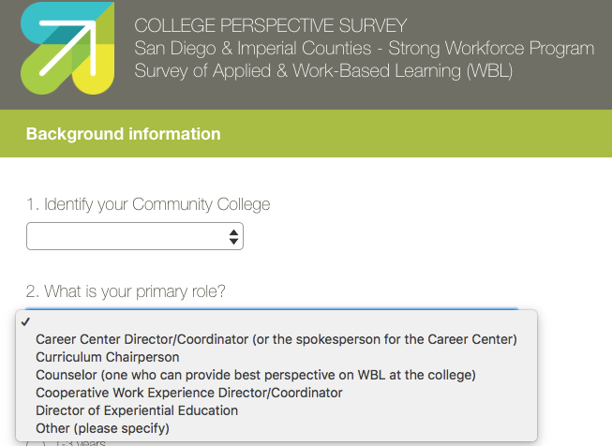

Slide 25
Inventory of Applied and Work-Based Learning Opportunities Offered
Inventory collects information from ALL program directors to establish baseline data on:
Number of opportunities offered in each program and course
Number of students served in each program and course
Support needed to engage employers
Support needed to improve applied and work-based learning
Notes:
HAND OUT copies of the Inventory for all to review

Slide 26
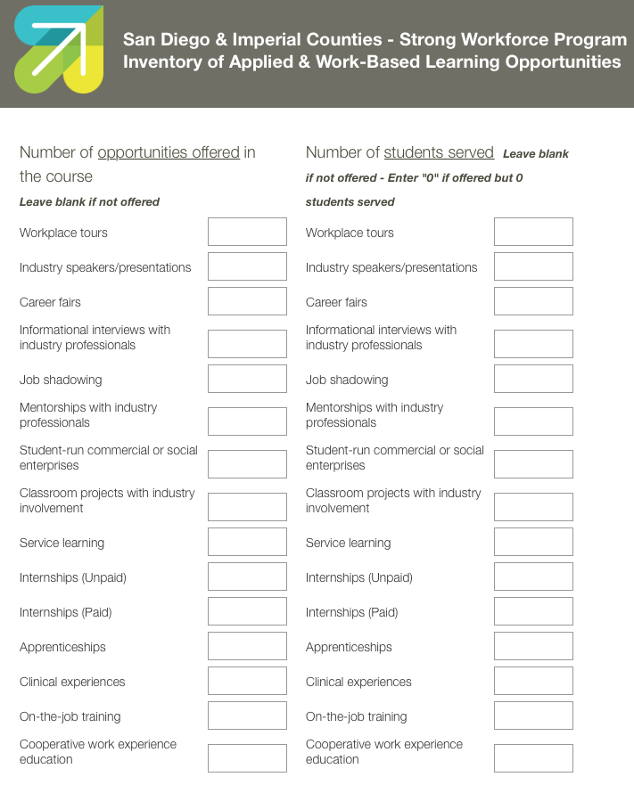

Slide 27
21st Century Skills and Core Competencies Faculty Survey
Survey collects information on:
Which 21st Century Skills and Core Competencies are being taught and how
Best practices for teaching these skills and competencies
Notes:
Each of the 10 community colleges in San Diego and Imperial Counties has identified core competencies that graduating students are expected to have mastered. The competencies cited as “core” vary only slightly from one institution to another and vary only slightly from the 21st century skills cited by universities and employers as critical to student success. The list of competencies/skills included in this survey is a combination of core competencies identified by the 10 community colleges in Region 10, the New World of Work, and the National Association of Colleges and Employers. This survey seeks to establish a baseline regarding which core competencies are being taught in which disciplines and how. It further seeks to solicit best practices for teaching core competencies and 21st century skills.
Faculty will be invited to present their strategies, lessons, and/or materials at a Region 10 Skills Symposium planned for April of 2019 and to earn a stipend of $350 for doing so.

Slide 28
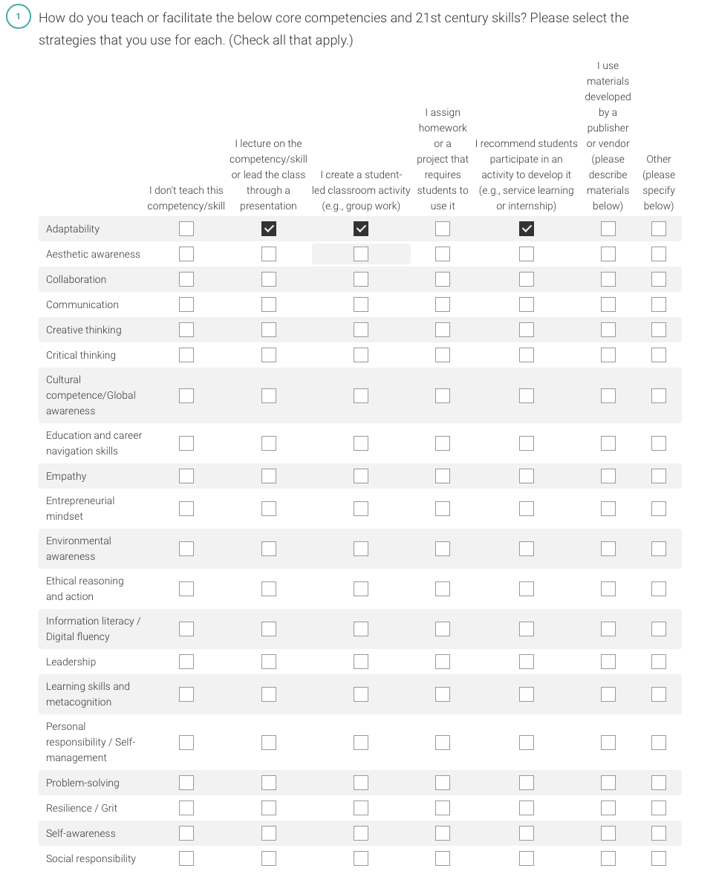

Slide 29
Survey Administration Process
Online survey links with email text will be provided by WestEd
Administration of the survey is coordinated by the SPC:
Identify respondents for the faculty surveys and use a distribution list of ALL faculty to send out emails with survey links.
Maintain the master distribution list to track the number of surveys administered and the overall response rate.
Coordinate with the Institutional Research office as necessary.
Identify respondents for the college perspective survey and personally orient them to the survey.
Notes:
WestEd will provide email with link by 10/11/18 for SPCs to customize for their campus
WestEd will provide reminder emails for SPCs to send out approximately 2 times
WestEd will provide unique survey links for each college to track which responses come from which college. Responses are anonymous unless respondent chooses to include their name for follow-up purposes.

Slide 30
Survey Administration Process
To launch the assessments, WestEd will send email text with links to SPC to forward to respondents
One survey per college; each survey will have a unique link
Survey responses are submitted electronically and directly to WestEd
WestEd will send SPC weekly updates on the number of responses
SPC sends reminders as necessary
WestEd compiles data and makes it available to the field
Notes:
WestEd will provide email with link by 10/11/18 for SPCs to customize for their campus
WestEd will provide reminder emails for SPCs to send out approximately 2 times
WestEd will provide unique survey links for each college, which will allow WestEd to track which responses come from which college.
Responses are anonymous unless respondent chooses to include their name for follow-up purposes.
WestEd will track responses weekly and provide numbers back to the SPCs for follow-up purposes.
Best to have respondents complete the surveys in one sitting.
For the inventory, in addition to providing a pdf of the assessments, WestEd has created a spreadsheet that the SPC or program staff can use to log data before they are ready to input the data to the online form – if needed.
(? Provide additional information on survey logistics from Joy or only if asked ?)

Slide 31
Inventory Administration Process
An electronic version of the WBL Inventory will be provided by WestEd
Completion of the inventory is coordinated by the SPC:
Personally contact division or department chairs and key program chairs (e.g., Career Center) to explain the purpose of the WBL Inventory and set up a time to meet with faculty, as appropriate.
Identify and list each of the programs/disciplines and course titles for the inventory and list them on the tracking sheet provided. (Career Center, internship programs, and other campus-wide programs offering WBL should be included as “programs” and the type of service should be included in the “course title” field.) Data is retrospective from the 2017-18 academic year.
Send identified respondents the link to the online inventory or contact them to gather the information. (A PDF version of the online inventory will be provided to help capture the data before it is entered online.)
Follow up with respondents as necessary to ensure all inventories are sent to WestEd.
Notes:
(Hand out Tracking sheet)
* (Consider a strategic approach – perhaps start with the programs that will likely provide the most data (those that offer the most WBL opportunities) *
Data is retrospective from the 2017-18 academic year. A year-long course should have one form submitted. A semester or winter session course should also have their own separate inventory forms.
Each course title (even if taught in multiple sections during a semester or trimester) can have only one inventory form completed so that there are no duplicate counts. For example, the number of opportunities offered and students served in the course “Auto 101” should be included in one inventory form. “Auto 102” would be considered a different course.
We are counting the number of discrete opportunities (actual opportunities offered) not the types of opportunities.) One field trip is just one opportunities that could be for 25 students but one job shadow could be for one student.
SPCs should include a PDF version of the Inventory in their email with the link to the online inventory. The hard copy can be used to record numbers then the online inventory can be completed in one sitting. Once “Done” is pressed at the end of the survey it will be automatically sent to WestEd.

Slide 32
Timeline
TASK SPC pre-work: Locate Distribution List for Faculty Survey Identify respondents for College Perspective Survey Identify respondents for WBL Inventory using tracking sheet provided Coordinate with the IR office or others as needed | TIMING Begin following 10/8/18 training
Administer Surveys: WestEd sends SPC email text with survey links SPC sends Faculty Survey to all faculty via Distribution List SPC sends College Perspective Survey to approximately 4 identified people SPC sends reminder emails WestEd sends weekly updates of # of responses to track response rates | WestEd will send link on 10/11/18 for SPCs to forward Survey will close on 10/31/18
Administration of WBL Inventory: WestEd sends SPC email text with link to electronic version of inventory SPC personally contacts division or department chairs and key program chairs to explain the purpose of the WBL Inventory and set up a time to meet with faculty, as appropriate. SPC identifies each of the programs/disciplines and course titles for the inventory. SPC sends identified respondents the link to the online inventory or contacts them to gather the information. SPC follows up as necessary and ensures all inventories are sent to WestEd. | WestEd will send link on 10/11/18 Complete and send to WestEd by 11/8/18
Notes:
Hand out Instructions that includes this timeline

Slide 33
Implementation Discussion
What are the logistical considerations for administering the surveys and inventory at your campus?
What kind of outreach and communication strategies might motivate faculty to complete the surveys?
Notes:
Give SPCs and their teams time to discuss implementation.
WBL survey is approximately 30-40 minutes long and 21st century skills/core competency survey is approximately 10 minutes long; WG4 had some ideas for motivating faculty to complete the surveys: provide time to complete the survey as a group activity during meetings on campus and offer food as an incentive; reserve the computer lab at certain times
(Note: SPCs may have questions about how best to administer the 2 surveys – timing for release of each. Surveys should be open for 2-3 weeks and closed by 10/31/18)
Inventory will also be administered during the same time period with one extra week (to be completed by 11/8/18)

Slide 34
Questions?

Slide 35
Thank you!

