Slide 1
Biomimicry

Slide 2
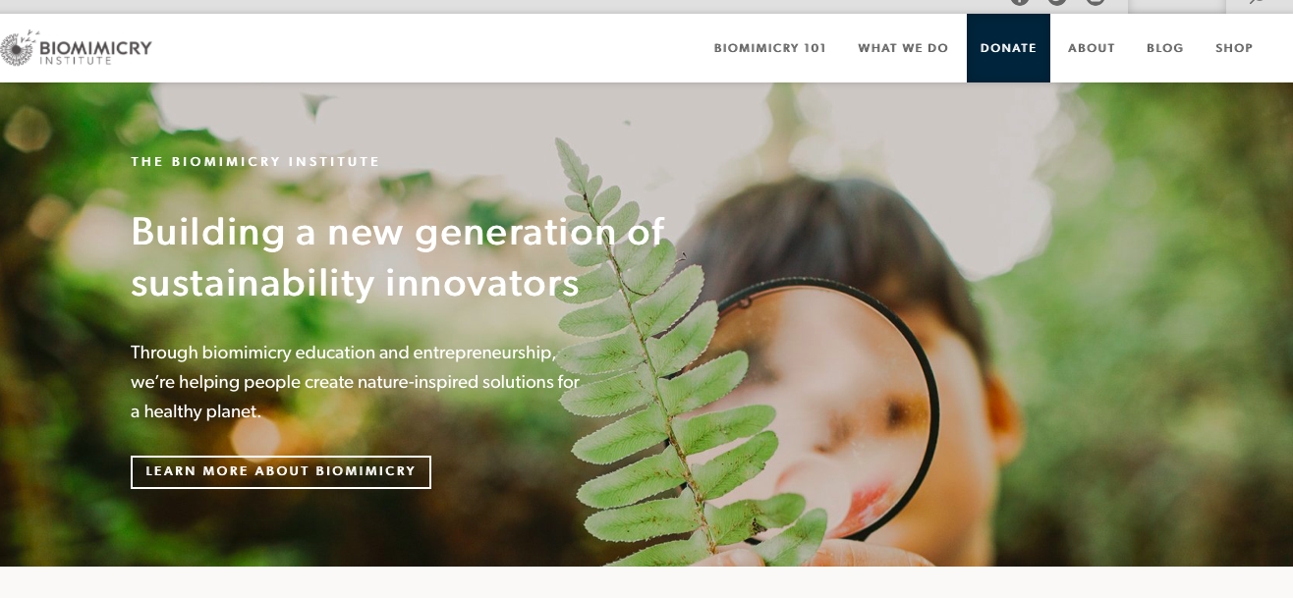
https://biomimicry.org
https://challenge.biomimicry.org/en/custom/gallery/directory

Slide 3
Get Started in Groups
Research:
Start with problem to solve
OR
Start with nature and find problem to solve
Ask Nature
https://asknature.org

Slide 4
Break into groups and look at research.
Collaboration rules
Listen and don’t interrupt
Respect all opinions
Stay on topic
No idea is bad

Slide 5
Brainstorm using concept map or other method
Each person creates own concept map at home and sketches of ideas
Group meets again to discuss individual ideas.
Group decides on a few ideas to discuss further and eventually agrees on one to further investigate

