Slide 1
Learning By Doing
Service Learning, a Creative Approach
Delores Loedel, Accounting Faculty at MiraCosta College

Slide 2
What is Service Learning?

Slide 3
What is Service Learning?
Service learning is a form of experiential education that partners academic instruction with community service. Students learn through participation in thoughtfully organized service activities that are course relevant and meet actual community needs
http://miracosta.edu/studentservices/servicelearning/index.html

Slide 4
What are the Advantages of Service Learning for the Student?

Slide 5
What are the Advantages of Service Learning for the Student?
Increase their understanding of the class topic
Gain hands-on experience (possibly leading to an internship or job later)
Develop critical thinking and problem-solving skills
Grow their understanding of diverse cultures and communities
Learn more about social issues and their root causes
Improve their ability to handle ambiguity and be open to change; become more flexible
Develop or enhance their skills, especially in the areas of communication, collaboration, and leadership
Test out their skills, interests, and values in a potential career path
Connect with professionals and community members who they will learn from
Grow a professional network of people they might connect with again later for jobs or internships
http://www.servicelearning.umn.edu/info/benefits.html

Slide 6
What are the Advantages of Service Learning for Faculty?

Slide 7
What are the Advantages of Service Learning for Faculty?
Encourage interactive teaching methods and reciprocal learning between students and faculty
Add new insights and dimensions to class discussions
Promote students' active learning; engage students with different learning styles
Develop students' civic and leadership skills
Provide networking opportunities with engaged faculty in other disciplines
Foster relationships between faculty and community organizations, which can open other opportunities for collaborative work
Provide firsthand knowledge of community issues; provide opportunities to be more involved in community issues
http://www.servicelearning.umn.edu/info/benefits.html

Slide 8
What are the Advantages of Service Learning for Community?

Slide 9
What are the Advantages of Service Learning for Community?
Gain additional human resources needed to achieve organizational goals
Inject new energy, enthusiasm, and perspectives into the organization's work
Grow the organization's volunteer pool: service-learning students will share their experiences with friends and classmates
Increase public awareness of key issues
Reach out to youth—an important part of any organization's future support
Educate students/youth about community issues; correct any misperceptions
Help prepare today's students to be tomorrow's civic leaders
Network with colleagues in other organizations and agencies
Identify and access other college resources; build relationships with faculty, students, and staff
http://www.servicelearning.umn.edu/info/benefits.html

Slide 10
Video Example of Service Learning in Action
https://www.youtube.com/watch?v=0r43dktZOpQ

Slide 11
If there are so many advantages, why don’t all faculty assign a service learning project?

Slide 12
If there are so many advantages, why don’t all faculty assign a service learning project?
Belief that there isn’t any type of service learning activity applicable to the learning objectives for the course
Belief that it will be too much work
Belief that it is just volunteer work and that students should do this on their own time and not as part of a college course
Belief that students will resist the assignment
Belief that since I’m teaching a beginning course that students won’t have the expertise needed to assist in the community in a meaningful way

Slide 13
If there are so many advantages, why don’t all faculty assign a service learning project?
Belief that there isn’t any type of service learning activity applicable to the learning objectives for the course. Once you open your mind to the possibilities, you will be amazed at how many opportunities there are and how easily adaptable they are to line up to your course learning objectives. Most colleges have a Service Learning department that would love to work with you to help you design your Service Learning experience.
Belief that it will be too much work. I will not lie, it is a lot of work, but it is worth it! I’ve grown as a person through my experiences as a faculty member with Service Learning. Once you work out the details, it gets easier.

Slide 14
If there are so many advantages, why don’t all faculty assign a service learning project?
Belief that it is just volunteer work and that students should do this on their own time and not as part of a college course. I believe all of the examples of how it benefits the student, the faculty, and the community answers this question.
Belief that students will resist the assignment. Some will resist and some may not have the means to complete the assignment. For this reason, it is important to give an alternative assignment (more on this later).
Belief that since I’m teaching a beginning course that students won’t have the expertise needed to assist in the community in a meaningful way. Honestly, there are some classes that obviously lend themselves more easily to Service Learning than others but I truly believe there are opportunities available for anyone who sets their mind to setting up a Service Learning assignment for their course.

Slide 15
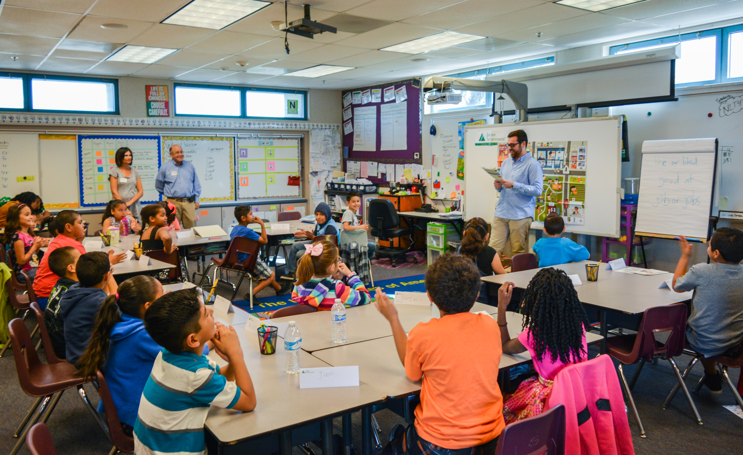
My Service Learning Assignment
Students volunteer with Junior Achievement (JA). JA is a nonprofit that focuses on Financial Literacy education in the K-12 schools.
Junior Achievement volunteers teach fun, interactive lessons about business to kids in kindergarten through 12th grades and help students understand how important a complete education is to their future success.
https://www.jasandiego.org/

Slide 16
Important Details of the Assignment
Students should be aware of the assignment right away. It should explained in the syllabus and explained in more detail on Canvas.
Students should be aware that there is an alternative assignment available (it should be in the syllabus and on Canvas). This assignment should have sufficient rigor and should be related in some way to what the Service Learning students are experiencing.
Tips: Have something that the students have to turn in early in the semester with low-stake points assigned. I have the students complete a planning form that tells me what JA program they will volunteer for and when.

Slide 17
Important Details of the Assignment
Tips: Have something that the student have to turn in close to the end of the semester with points assigned that assures they have completed their Service Learning assignment. I have the students turn in their Service Learning timecard.
Reflective Essay: My students must complete a reflective essay. This is the majority of the points for the assignment. The essay must give information on the history and mission of the service organization (JA). It must also explain what they did, what they learned, and how the experience helped them grow as a person and as a student. Another great option: Reflective Video
Reflection Discussion Board: Students complete a reflective discussion board post where they briefly give a reflection on their experience and respond to two other student’s postings.

Slide 18
Benefits I’ve Experienced
Developed working relationship with JA which has led to other collaborative events (STREAM event recently)
Experienced the benefit of reading how this experience has changed many student’s lives.
In order to make sure I knew what students would be experiencing, I volunteered in all of the JA programs several times at many different schools. I Received the North County JA Volunteer of the Year Award!
This afternoon, three of my former students will be presenting their experience in Service Learning at the Service Learning Celebration at MiraCosta College!

Slide 19

Brainstorm! How Can you Implement Service Learning in Your Classroom?

