Slide 1
Career Technical Education Minimum Qualifications Tool Kit
Academic Senate: Cheryl Aschenbach, Rebecca Eikey
Chancellor’s Office: Dr. Lynn Shaw, Dr. Grant Goold
Notes:
Lynn describes the taskforce and areas of recommendations

Slide 2
25 Strong Workforce Recommendations Adopted by the Board of Governors in Fall 2015
Student Success
Career Pathways
Workforce Data & Outcomes
Curriculum
CTE Faculty
Regional Coordination
Funding
Notes:
Lynn describes recommendation 13

Slide 3
“Increase the pool of qualified CTE instructors by addressing CTE faculty recruitment and hiring practices.
Clarify legislative and regulatory barriers to hiring CTE instructors who may not meet existing college hiring standards, but possess significant industry experience.
Disseminate effective practices in the recruitment and hiring of diverse faculty and the application of minimum qualifications and equivalencies.
Develop pipelines to recruit community college faculty with industry expertise through collaborations with higher education, business, and industry professional organizations.
Establish a mentorship model that delineates pathways for industry professionals to intern at colleges to gain teaching skills, knowledge, and experience while pursuing an associate degree or an equivalent.”
Notes:
Lynn gives history of the Workgroup

Slide 4
Chancellor’s Office CTE Minimum Qualifications Work Group Membership
Academic Senate
Chief Instructional Officers
College Presidents
Human Resources
California Community College Chancellor’s Office
Notes:
Grant gives content of Tool Kit

Slide 5
CTE Minimum Qualifications Tool Kit
Equivalency
Faculty Internship
Apprenticeship Minimum Qualifications
And More
Notes:
Grant describes GEEM

Slide 6
CTE Minimum Qualifications Tool Kit
Sample Contents
Pre-planning checklist for Equivalency by Department
Equivalency Checklist for Human Resources Departments
Model Equivalency Committees Composition and Policies
Information and Checklist for Potential Equivalency Applicants
Credit for Prior Learning
Notes:
Grant describes GEEM

Slide 7
Why General Education?
Purpose of GE is to produce a citizen who can interact effectively with the world around them based on critical thinking and reasoning, sound oral and written communication, an applied understanding of other peoples and cultures, and applied experiences with science and its impact on people.
Notes:
Cheryl describes general education

Slide 8
What General Education is required for an Associate of Arts or Associate of Sciences?
GE for an AA degree includes demonstrated competencies in math and English along with 18 units in 5 areas:
A. Natural Sciences
B. Social and Behavioral Sciences
C. Humanities
D.1. Language and Rationality: English Composition
D.2. Language and Rationality: Communication and Analytical Thinking
Notes:
Cheryl talks about all the specific areas of the general education areas focusing on the cte examples

Slide 9
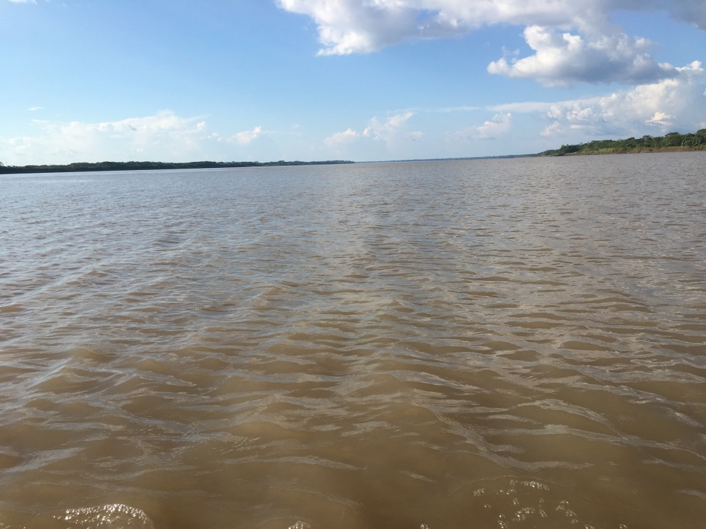
General Education Area A Natural Sciences
Example: Aviation (Certified Flight Instructor)
A certified recreational, private, or commercial must
understand and apply Newton’s Basic Laws of Motion
and Bernoulli’s Principle Ref: FAR 61.185(2)
Purpose for Including One Course in Natural Sciences for General Education
For students to develop the ability to examine the physical universe, its life forms, and its natural phenomena
For students to develop an appreciation of, understanding of, and ability to apply the scientific method
For students to develop the ability to understand the relationship between science and other human activities
Notes:
Cheryl talks about all the specific areas of the general education areas focusing on the cte examples

Slide 10
General Education Area B Social and Behavioral Sciences
Example: Culinary Arts/Food Production
A chef or culinary artist works within varied ethnic
foods and understands and applies an understanding
of foods and culture as well as historical food trends
Purpose for Including One Course in Social and Behavioral Sciences for GE
For students to develop an awareness of the methods of inquiry used by the social and behavioral sciences.
To stimulate students’ critical thinking about ways people act or have acted in response to their societies
To promote students’ appreciation of how societies and social subgroups operate
To develop or promote a students’ understanding and appreciation of ethnic groups (Title 5 §55063 (b)(2) requires a course in Ethnic Studies. It is most likely met through the course/experience/ability counted in Area B or Area C)
Notes:
Cheryl talks about all the specific areas of the general education areas focusing on the cte examples

Slide 11
General Education Area C Humanities
Example: Mortuary Science
Certified Funeral Service Practitioners complete
Celebrant training to develop an awareness of traditions
of different cultures and religions
Purpose for Including One Course in Humanities for GE
For students to develop an awareness of the way in which people throughout the ages and in different cultures have responded to themselves and the world around them in artistic and cultural creations.
For students to develop or demonstrate aesthetic understanding and an ability to make value judgements.
To promote a students’ understanding and appreciation of ethnic groups (Title 5 §55063 (b)(2) requires a course in Ethnic Studies. It is most likely met through the course/experience/ability counted in Area B or Area C)
Notes:
Cheryl talks about all the specific areas of the general education areas focusing on the cte examples

Slide 12
General Education Area D.1. Language and Rationality: English Composition
Example: Any Discipline
Publishing a peer-reviewed article
Writing of a market, technical or sales report or manual, or writing of a similar document within the work environment
Purpose for Including English Competency and One Course in Language and Rationality: English Composition for General Education
For students to develop the principles and applications of language toward logical thought, clear and precise written expression and critical evaluation of written communication in whatever symbol system the student uses.
For students to develop expository and argumentative writing skills (English Composition)
Notes:
Cheryl talks about all the specific areas of the general education areas focusing on the cte examples

Slide 13
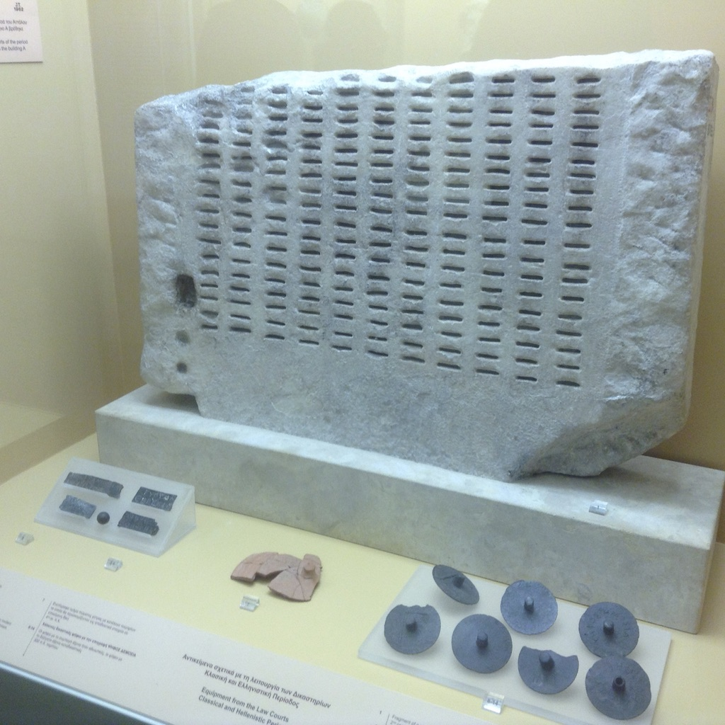
General Education Area D.2. Language & Rationality: Communication & Analytical Thinking
Example: Automotive Technology
A licensed automotive technician must use mathematical skills to manage and calculate ratios, measurements, comparisons, and specifications related to investigation of problems; may also use mathematical skills and reasoning to machine parts and tools to exact specification.
Purpose for Including One Course in
Language and Rationality for General Education
For students to demonstrate competence in mathematics at a level equivalent to intermediate algebra
For students to develop oral communication and analytical thinking skills
For students to develop skills interpreting and assessing data and statistics to draw conclusions.
Notes:
Cheryl talks about all the specific areas of the general education areas focusing on the cte examples

Slide 14
Next Steps
Academic Senate California Community Colleges Technical visits, as requested (https://www.asccc.org/contact/request-services)
Release Toolkit via ASCCC, CCCCO, Vision Resource Center

Slide 15
Academic Senate info@asccc.org
Cheryl Aschenbach caschenbach@lassencollege.edu
Rebecca Eikey rebecca.eikey@canyons.edu
Lynn Shaw shawlynn@gmail.com
Grant Goold gooldg@arc.losrios.edu

Slide 16
Notes:
Lynn facilitates questions and comments

