Slide 1
Teaching Self-Awareness
Presentation by Arnie Schoenberg for the Region 10 Skills Symposium sponsored by the San Diego/Imperial Valley Region Strong Workforce Program

Slide 2
What is self-awareness?
“Self-awareness is the capacity for introspection and the ability to recognize oneself as an individual separate from the environment and other individuals.”

Slide 3
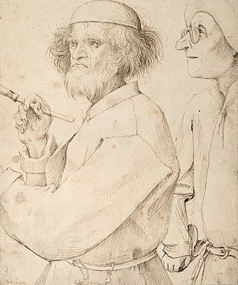
The ART of self-awareness?
Self-awareness is how an individual consciously knows and understands their own character, feelings, motives, and desires.
“The Painter and the Buyer" (1565)
by Pieter Brueghel the Elder

Slide 4
Broad Categories of Self-awareness:
internal self-awareness
external self-awareness.

Slide 6
Self-awareness Test Correct Answers
b
b
e
b
s

Slide 7
Reference Cited
Self-awarness Wikipedia https://en.wikipedia.org/wiki/Self-awareness last updated: April 28, 2019. accessed: May 1, 2019.

