Slide 1
Career Skills Across the Curriculum
Promoting 21st Century Skills and Work-Based Learning Curriculum every teacher can use in their classroom disciplines
Presenters: Cindy Morrin, Lorena Quiroz, Nadine Elia Cuyamaca College

Slide 2
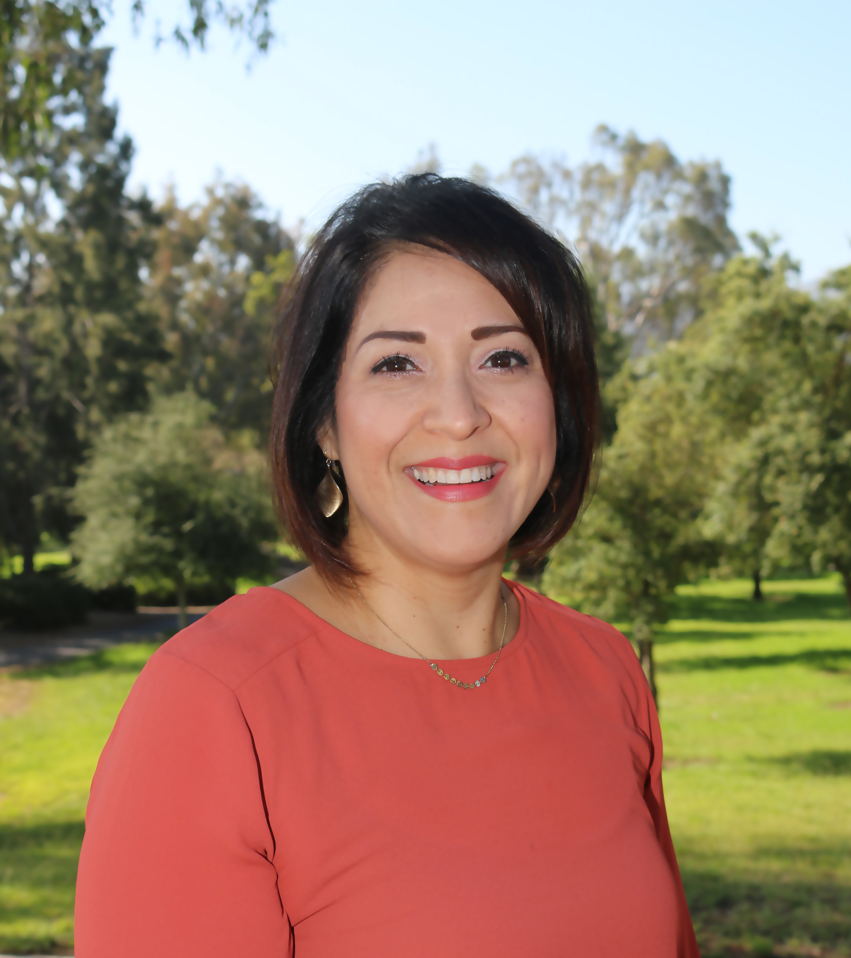
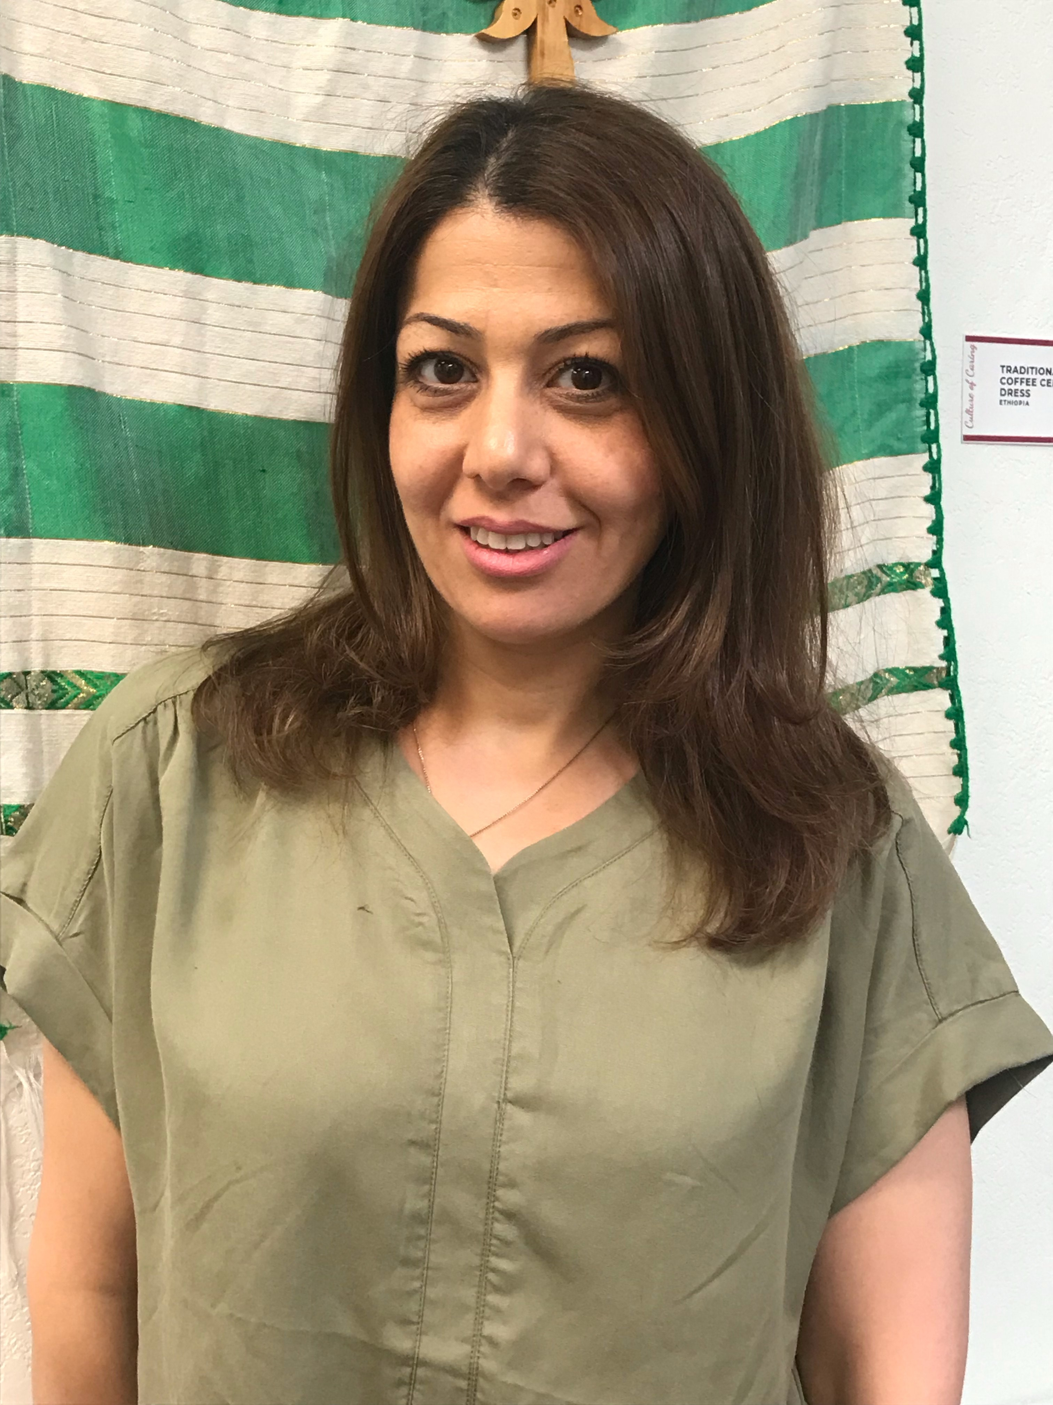
Who We Are
Cindy Morrin Faculty Curriculum Chair Phi Theta Kappa Advisor Counseling Faculty Cuyamaca College
Lorena Quiroz
Interim Career Services and Job Development Supervisor
Cuyamaca College
Nadine Elia
SDICCCA Fellow CalWORKs Counselor
Grossmont College
Health Education Interpreter and Tutor
Cuyamaca College

Slide 3
What is Work-Based Learning?
Networking
Resume Writing
Interviewing
Career Assessment
Portfolio Development
Informational Interviews
Internships
Apprenticeships
Informational Interviews
Social Networking
Branding in the Digital Age

Slide 4
What are 21st Century Skills?
Adaptability
Aesthetic Awareness
Collaboration
Communication
Creative Thinking
Critical Thinking
Cultural Competence
Education/Career Navigation Skills
Empathy
Entrepreneurial Mindset
Environmental Awareness
Ethical Reasoning/Action
Information Literacy/Digital Fluency
Leadership
Learning Skills/Metacognition
Personal Responsibility/Self-Management
Problem-Solving
Resilience/Grit
Self-Awareness
Social Responsibility

Slide 5
4-STEP ELEVATOR SPEECH
STEPS | CONSIDER THE FOLLOWING…
Who are you? | Name/Major/Year
What can you offer to employer? | Your selling points: experience, skills, projects
What do you want? | Short description of your short-term goal
What is your bounce back question? | Open-ended question (What do you do?)

Slide 6
Put It All Together
(WHO) Hi. My name is….and I’m a freshman studying Psychology at Cuyamaca College.
(WHAT) I have been volunteering at the YMCA for the past six months, where I’ve gained experience caring for children, working in a team, and communicating effectively with my teammates and parents.
(GOAL) I’m looking into finding a part-time position on campus where I can apply my customer service and teamwork skills.
(QUESTION) What do you enjoy best about your work?

Slide 7
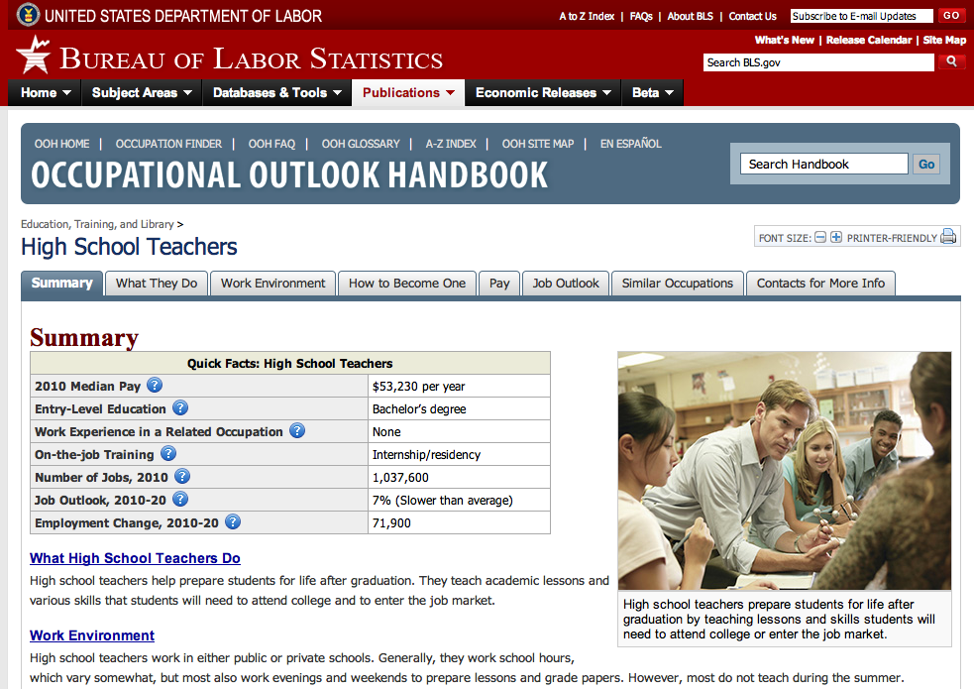
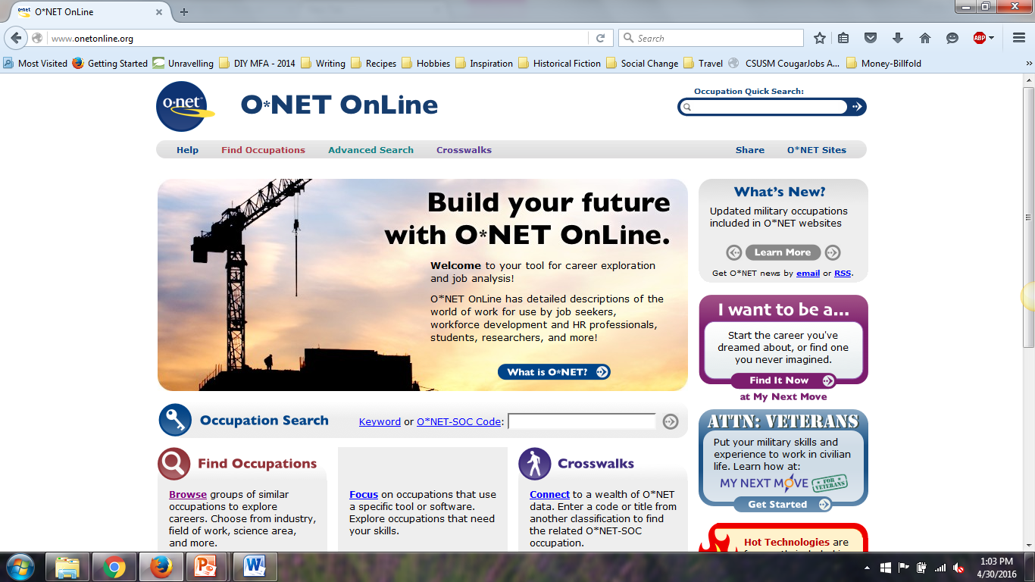
Occupational Activity
Occupational Outlook Handbook
O*Net Online
My Next Move will help students find out what their interests are and how they relate to the world of work.
http://www.mynextmove.org/explore/ip
https://www.bls.gov/ooh
https://www.onetonline.org/

Slide 8
Exploring one career
What jobs are available if you are a Psychology major?
School- Teacher’s assistant
For or Non-profit organization- Social Services
Healthcare- Patient Care Representative
College- Tutor
Community Based organization- Job Coach

Slide 9
California Career Zone
https://www.cacareerzone.org/

Slide 10
What is an Informational Interview?
An informational interview is a meeting with an employer or professional within a specific career industry.
Easiest and most effective ways to meet people in a professional field!
By doing so you can do the following:
Meet key professionals
Gather career information
Investigate career options
Obtain advice about job search techniques
Obtain referrals for other professionals

Slide 11
Informational Interview Activity
Goal: Familiarize your students with the concept of conducting informational interviews, and help them bolster their confidence and ability to conduct these interviews on their own.
Directions:
Ask students to think about a professional in your area of study whom they find particularly interesting and would like to know more about. Students will conduct an informational interview—they will learn more about this professional interests and career. They should write down ten questions to ask and visit the instructor during office hours to conduct an interview. Have students make a presentation about what they learned.
In-class discussion Questions (Optional):
1. How did you prepare for your interview? How might you prepare differently for a professional in your ideal career?
2. What factors went into choosing a faculty member to interview? How did they react to being asked for an interview?
3. How might you go about asking for an informational interview from someone outside of your school? How would you find a suitable person to interview?
4. How did you feel during the interview? Was the environment open, casual, engaging? How might you ensure that future interviews are set in this sort of environment?
5. How might you prepare for or conduct an interview differently, knowing what you know now? Do you feel more prepared or more likely to seek out informational interviews in the future?

Slide 12
Why
Most professional
Over 100 million users
Networking
95% of recruiters source on LinkedIn
Exposure and self-marketing
Join professional groups
Extensive job listings
Research: companies, professionals

Slide 13
E-Portfolios - Portfolium
Electronic portfolios or ePortfolios are the new resume
Employers and recruiters want candidates to show them what they’ve done, not just tell them
Electronic materials document accomplishments and may include papers, videos, pictures and hyperlinks, assembled in an online web platform
ePortolios allow students to showcase projects and achievements in a visual way to communicate knowledge and skills gained through their academic experiences and within classroom disciplines
Portfolium - integrates job search technology so students can apply for jobs and submit their ePortfolio as part of their application.
https://portfolium.com/
Student Example: https://portfolium.com/ShabrikaKing

Slide 14
Digital Fluency
Google search of your name
Try it now! Type your first and last name in the Google search bar and watch the results filter in
Need to be more specific? Include the city and state that you live in after your name
What did you find?
Remember that in addition to using online tools to find general information, you can find specific information about your own “digital footprint”

Slide 15
Handouts for workshops
WBL and Learning Opportunities Ideas
30-second elevator speech
Informational Interview activity
Informational interview questions
Occupational Outlook Handbook Activity
Sample My Next Move summary
California Career Zone Directions
Linkedin Building a Student Profile

