Slide 1
CEO Quarterly
SWP Workshop
September 9, 2019
Notes:
Is this the title we want?
Add Ben’s and/or Mollie name/title?

Slide 2
Original Investments
  Data and Research
  Marketing
  Career Pathways
  Employment Readiness &
  Job Placement
2. New Investment
  Strong Workforce Faculty Institute
Today’s Update

Slide 4
Accountability Outcomes | Vision Goals | Funding Formula | Student Success | Strong Workforce Program
9+ CTE Units in a Year |  | x | x | x
Completed Noncredit Workforce Milestone |  |  | x | x
Transfer-Level Math & English in a Year |  | x | x
Average Number of Units for Degree Earners | x |  | x
Completers/Completions Over 16 Units | x | x | x | x
Transfers to Four-Year Institutions/UC and CSU | x | x | x | x
Job in Field of Study | x |  | x | x
Living Wage Attainment |  | x | x | x
Median Annual Earnings |  |  | x | x
Change in Earnings |  |  | x | x
College Promise Grants/Pell Grants/ Perkins Economically Disadvantaged |  | x | x | x
Data Sources: CO MIS, CO Transfer Bucket, EDD Unemployment Insurance data, CTE Outcomes Survey,
Dept. of Apprenticeship Standards
Notes:
California is one of a handful of states that has included employment and earnings outcomes in its accountability framework and funding formula.

Slide 5
DATA & RESEARCH

Slide 6
DATA & RESEARCH
Number of Requests for Labor Market Information

Slide 7
DATA & RESEARCH
Number of People Exposed to Research
Notes:
Methodology: 1. Log into the COE Constant Contact 2. Select “Campaigns” 3. For each campaign in the year analyzed, click “Open Rate.” 4. Click on “Export All” to get the list of emails that reviewed the eNews 5. “Export” list of emails for each of the campaigns listed above 6. Use Excel to de-duplicate the emails, to determine the total number of unique emails who received COE’s data/reports/research

Slide 8
MARKETING

Slide 9
GOALS
Increase awareness of Career Education programs
Create a unified regional brand for Career Education
Increase Career Education enrollments by 1%
Notes:
Unify SD/IMP’s 10 community colleges under one regional brand, an extension of the Strong Workforce brand
Develop a creative campaign promoting the value of Career Education in SD/IMP: “Learn More. Earn More.”
Focus creative executions on brand awareness or enrollment, depending on campaign/timing
Increasing enrollment in Career Education programs
Started in June 2018; beginning our second year
Learn More. Earn More.
ROI/Enrollment Data
ROI/Google Analytics
Noncredit programs

Slide 10
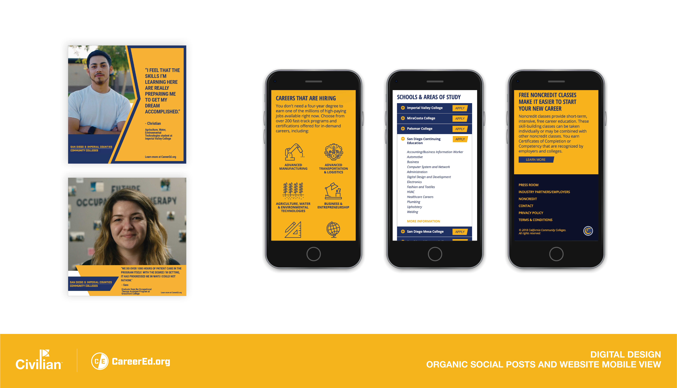

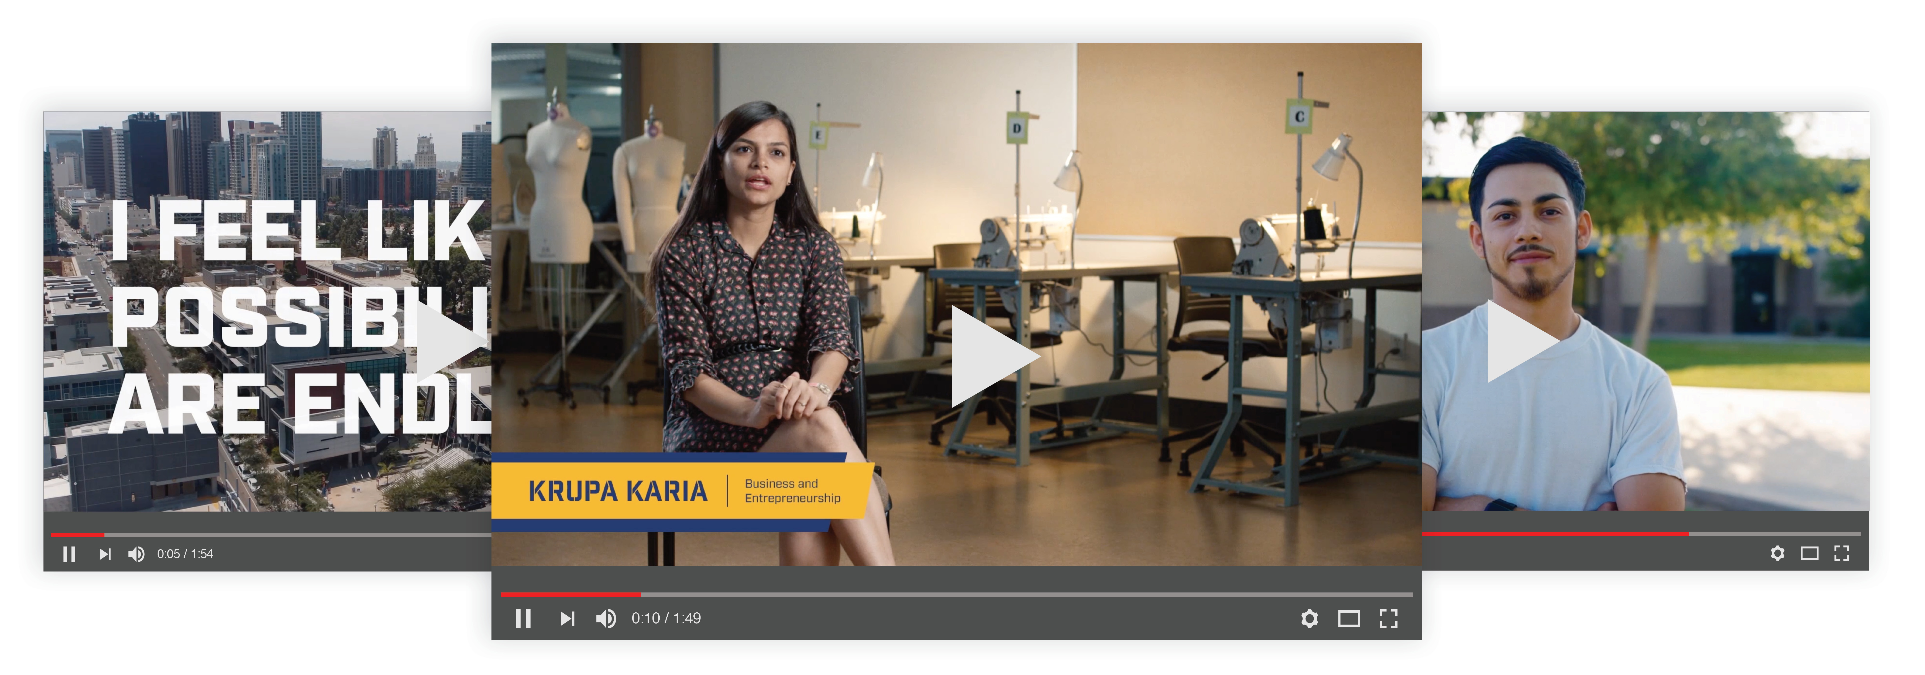
CAMPAIGN CREATIVE
MOBILE FIRST WEBSITE
SOCIAL
DIGITAL
VIDEO
Notes:
We have a beautiful and robust regional image library
Created as a result of a photoshoot with representations from all of our schools
Authentically captures students in a total of twenty Career Education classes.
We updated images on CareerEd.org too (pictured on the far right)
Social: Those engaging with us on social are not surprising doing so via their mobile devices
Paid Search: Top performing keywords included: health careers, electrical training, technician medical, welding, and medical technician programs.
Digital Advertising:
Our display ads have been a great success
Performing 3x higher than the industry benchmark.
People gravitated towards our Welder and Lab Technician creative, which garnered some of our best result
Videos
Student Success Stories

Slide 11
MEASURING ROI
WHAT We Measure | 1. ADS TO CLICKS | 2. CLICKS TO APPLY | 3. APPLICATIONS TO ENROLL | 4. ENROLLMENTS TO COMPLETIONS
WHERE It Happens | CareerEd.org | All Institution Websites | CCCApply | All Institutions
HOW It Happens | Marketing Campaign | Referrals from CareerEd.org and other sources | Referrals from College Sites | All Institutions (Student Retention, Success & Support, On-boarding)
WHO Is Responsible | Marketing | Marketing | Individuals Institutions | All Institutions

Slide 12
ENROLLMENT DATA TOTALS (DataMart)
Number of
Total CTE
Enrollments
Notes:
(RECONCILE THIS SLIDE WITH NEXT SLIDE ON ENROLLMENT)
Using enrollments is ultimate outcome of marketing efforts.
DataMart - 18-19 data available in Sept also?
Methodology
DataMart – enrollment and enrollment by high priority sectors; Kathy provided crosswalk between top codes and priority sectors
Credit and non-credit course enrollments: https://datamart.cccco.edu/Courses/Default.aspx
Vanessa provided extensive methodology section – See Box.
Total enrollments by year were:
15-16 – 1,066,321
16-17 - 1,078,378
17-18 – 1,067,622

Slide 13
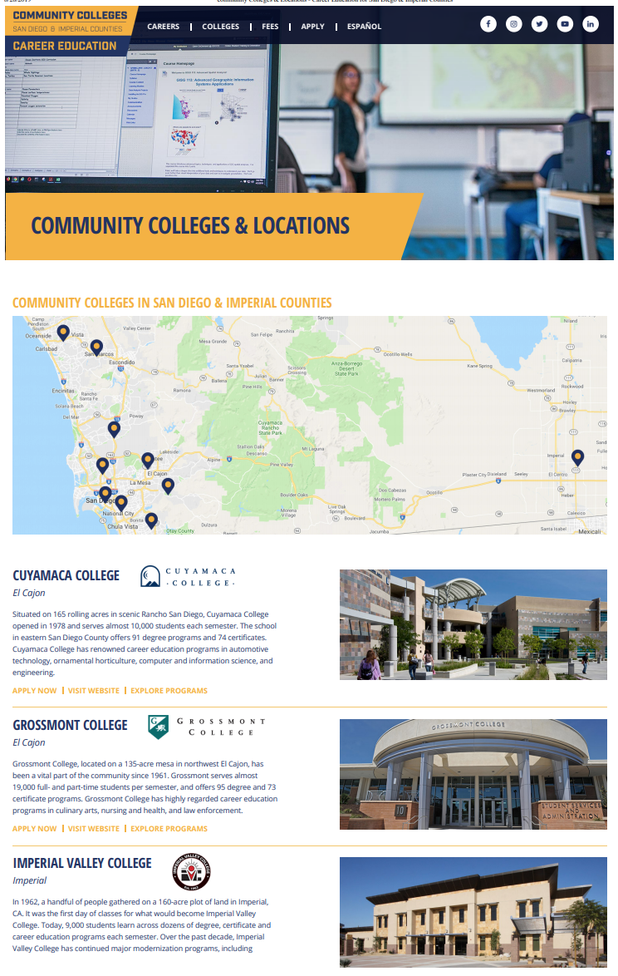
GOOGLE ANALYTICS
Click to apply metrics
Participation from all institutions
Needs from institutions
  Use Google Analytics to track/report activity
  Report to Civilian on a monthly basis
Fall training sessions available for PIOs/Webmasters
Notes:
Application activity on college sites by users referred from CareerEd.org
Asking each college PIO/webmaster to:
Use Google Analytics to track/report activity (e.g., clicks on “Apply Now”)
Report to Civilian on a monthly basis
The limitations of Google Analytics are
that it requires each school to participate/provide data (some schools aren’t participating)
It’s not retroactive, we can only capture data moving forward

Slide 14
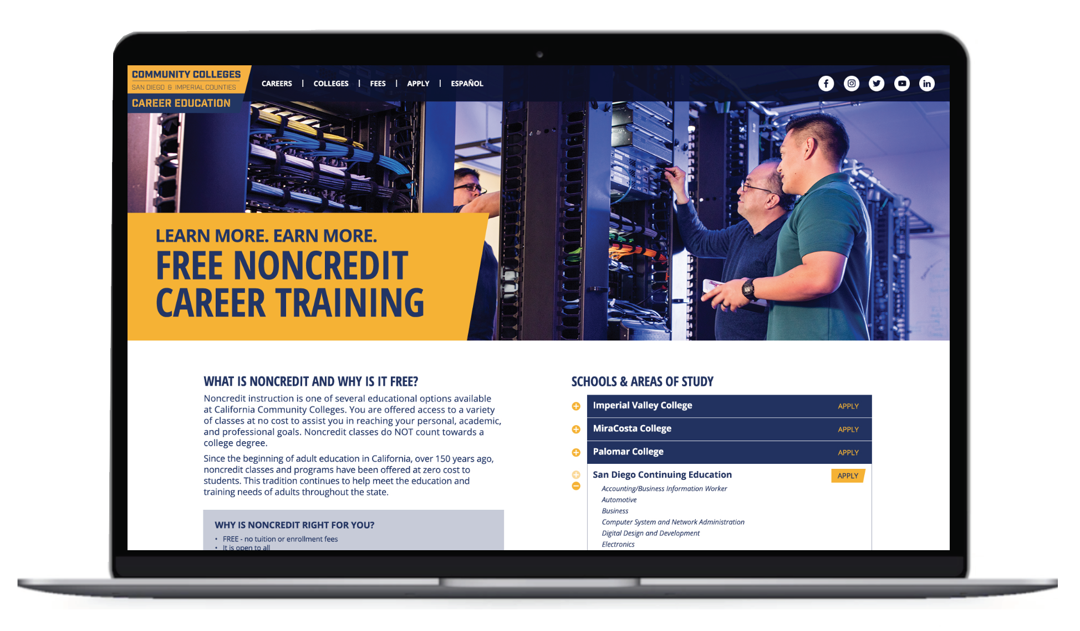
NONCREDIT

Slide 15
CAREER PATHWAYS

Slide 16
CAREER PATHWAYS
Number of Programs Recommended & Approved
Notes:
No data collected on recommendations on 2014-15.
DISCUSS 17-18 INTERNALLY:
(notes from Leslie)
Discrepancy in 17-18 - Mesa and Southwestern each had a lot of programs approved by the Chancellors office that year (not sure why). We know there is a lag time between local recommendation and state approval so this may account for some of the discrepancy.
Methodology:
Program recommendations that have been made by Deans/WDC during each academic years according to priority sector.
Data sources:
https://www.regionalcte.org/ (fall 2017 to present) and the WDC Program Recommendations page (2015-2017) of SWP website (http://myworkforceconnection.org/committee-sub/approved-programs/). To crosswalk them to the priority sectors, used the TOP-DWM file from Tina. And when a TOP code wasn’t provided, I used the attached COCI file to identify the TOP code.

Slide 17
CAREER PATHWAYS
Number of “Special Admit” Students
Notes:
This is proxy for dual enrollment.
Does not distinguish between CTE and non.

Slide 18
Number of K-12 Pathways by Sector for Districts in San Diego
And Imperial Counties (Source: WestEd Pathway Mapping 2019)
CAREER PATHWAYS
Sector | K-12 Pathways Across Districts
Arts, Media, and Entertainment | 99
Engineering and Architecture | 58
Information and Communication Technologies | 59
Health Sciences and Medical Technology | 57
Agriculture and Natural Resources | 36
Education, Child Development, Family Services | 30
Hospitality, Tourism, and Recreation | 28
Transportation | 27
Building and Construction Trades | 22
Business and Finance | 20
Manufacturing and Product Development | 18
Public Services | 13
Fashion and Interior Design | 10
Marketing, Sales, and Services | 7
Energy, Environment, and Utilities | 1
Grand Total | 485
Number of K-12 Pathways By Sector
Notes:
Note: 16 schools were excluded from this count due to incomplete data from these schools; often, they did not provide a sector name or pathway name. These schools include: Urban Camp, GRF, La Mesa Community School, San Pascual Academy, Innovations, EMJDF, Bayside Community School, Monarch School, San Diego City College, Missions Hills High School, 37ECB Community School, Hoover High, Coronado High School, Ramona High School, Rancho Buena Vista High School, and San Marcos High School

Slide 19
EMPLOYMENT READINESS &
JOB PLACEMENT

Slide 20
EMPLOYMENT READINESS & JOB PLACEMENT
Career Development Activities
Career assessments
Career research
Workplace orientation
Resume building
Interview training
LinkedIn profile development
Notes:
Totals above are “of the colleges that reported on a given year” - Many colleges reported no data for several years (not available, not collected/tracked). Totals above are for those colleges reporting in each category (i.e., colleges with no data reported got = 0). (SEE BELOW)
The above can then be interpreted that significant increase is due somewhat to increase in collecting/reporting the data
Requested “unduplicated counts” but some colleges reported using methods that which would not offer unduplicated counts (sign-in sheets, syllabus review, class enrollment, etc)
Other sources included:
SARS, Peoplesoft and other student data systems
“Participation estimates”
Student surveys
Employer surveys
COLLEGES NOT REPORTING BY YEAR (Career Dev) not reported meant “NA” “did not track” “not’ collected” “not available”
15-16 = 5 (cuyamaca, grossmont, IVC, palomar, SDCE)
16-17 = 4 (grossmont, IVC, palomar, SDCE)
17-18 = 2 (IVC, palomar)
18-19 = 0 (all reported)

Slide 21
EMPLOYMENT READINESS & JOB PLACEMENT
Work-based Learning Activities
Informational interviewing
Industry speakers
Job shadowing
Service learning
Workplace tours
Career fairs
Internships
Clinical experiences
Notes:
NOTE: This is the version WITHOUT Southwesterns data included. (per notes from 8/29 meeting)
++++++
Totals above are “of the colleges that reported on a given year” - Many colleges reported no data for several years (not available, not collected/tracked). Totals above are for those colleges reporting in each category (i.e., colleges with no data reported got = 0).
The above can then be interpreted that significant increase is due somewhat to increase in tracking the data
Requested “unduplicated counts” but some colleges reported using methods that which would not offer unduplicated counts (sign-in sheets, syllabus review, class enrollment, etc)
Other sources included:
SARS, Peoplesoft and other student data systems
“Participation estimates”
Student surveys
Employer surveys
COLLEGES NOT REPORTING BY YEAR (WBL)- not reported meant “NA” “did not track” “not’ collected” “not available”
15-16 = 5 (cuyamaca, grossmont, miramar, SDCE, southwestern)
16-17 = 5 (cuyamaca, grossmont, miramar, SDCE, southwestern)
17-18 = 3 (cuyamaca, SDCE, southwestern)
18-19 = 0 (all reported)

Slide 22
EMPLOYMENT READINESS & JOB PLACEMENT
Number of Students Exposed to Work Experience
Notes:
CONFIRM – BEN’S FEEDBACK WAS TO REMOVE THIS (currently not in list on slide #3)
NOTES ON DATA:
52% increase from 2015-16 to 2017-18, implying growing opportunities to teach 21st Century Skills and prepare students for future careers.

Slide 23
EMPLOYMENT READINESS & JOB PLACEMENT
CTE Degrees and Certificates Awarded
Notes:
AAT/AST - for Transfer
Key finding: increases in all kinds of award types, esp certificates less than 30 units.
https://datamart.cccco.edu/Outcomes/Program_Awards.aspx.
Vanessa provided detailed methodology in Box folder.
https://wested.box.com/s/ns75agak580mc2q9y94ldk1r5sv0vp66
Notes:
2018-19 data planned to be available from DataMart in Sept, 2019
Only credit awards included in this summary; non-credit awards were excluded)

Slide 24
STRONG WORKFORCE FACULTY INSTITUTE:
RETENTION & SUCCESS
Notes:
Highlighting a new initiative!
Two investments but one RFA:
Funding will be given to the college and the college decides how to distribute the funding for the 20-25 faculty and $250K for the research department
Rethinking the student experience for retention and success

Slide 26
THE PURPOSE OF THE INVESTMENT
Examine enrollment to completion:
  Retention and success at the course level
  Classroom practices
  Retention and success of disproportionately impacted populations
  Target local resources and redesign practices

Slide 27
A PROFESSIONAL LEARNING OPPORTUNITY FOR FACULTY
SWP Institute participants will:
Attend 2 in-person professional learning events
  February 28, 2020
  Fall 2020
Engage in an investigative project
Develop an action plan for the classroom
Receive a $2,000 stipend
Min 20, max 25 faculty per college

Slide 28
AN INVESTMENT IN RESEARCH
Funding will be available through a Request for Applications (RFA) to support and build the research capacity at each campus
$250K over a period of 3 years
Sep 23, 2019: RFA released
Nov 22, 2019: RFA responses due
Dec 2019 – Jan 2020: Researchers prepare for SWP Institute

Slide 29
PROGRESS SO FAR…
Presented concept for feedback
16 project team members
19 advisory group members with representation from each institution
Questions for investigative project completed
RFA draft in process
Orientation for prospective participants scheduled
Notes:
Orientation for prospective participants scheduled:
Tue, Oct 1, 3-4 pm
Tue, Oct 1, 9-10 am

