Slide 1
Active Learning
Collaboration

Slide 2
Why Learning Should be Active

Slide 3
Why Learning Should be Active
Active
Passive

Slide 4
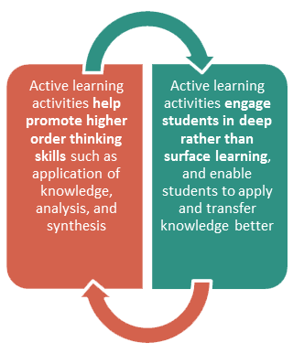
Why Learning Should be Active

Slide 5
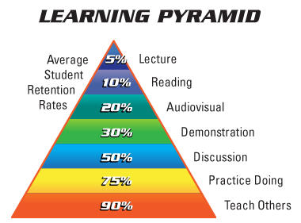
Why Learning Should be Active

Slide 6
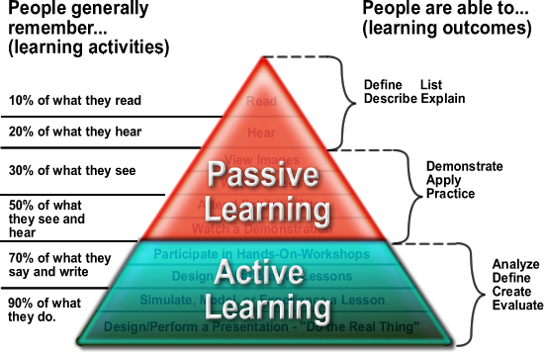
Why Learning Should be Active

Slide 7
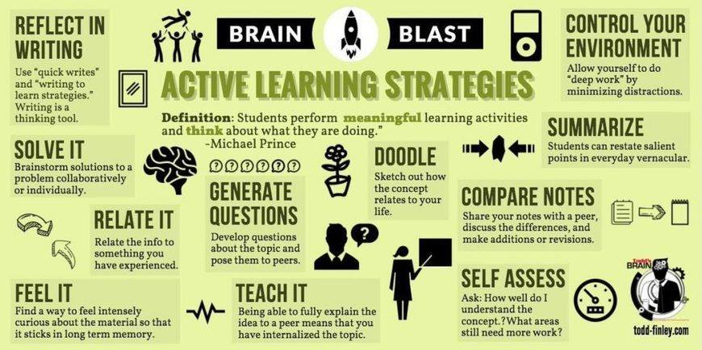

Slide 8
Designing Activities

Slide 9
Key Principles of Active Learning
The task has purpose and relevance to the students.
The students are able to reflect on the meaning of what they are doing.
The students can negotiate goals and methods.
Adapted from Barnes, D. Active Learning. Leeds University TVEI Support Project, 1989.

Slide 10
Key Principles of Active Learning
The students can critically evaluate different ways and means of learning.
The complexity of the learning task is comparable to professional contexts and real life, if applicable.
Adapted from Barnes, D. Active Learning. Leeds University TVEI Support Project, 1989.

Slide 11
Design Methods
Start with a mathematical concept
It should be relevant to the class
It should be a rich topic – multiple approaches
It should be challenging to the students

Slide 12
Design Methods
Choose a situation
It can be a real world situation
It can be a mathematical situation

Slide 13
Design Methods
Include a Write up or Reflection
Students write about what they have done
Some activities require a recommendation or report

Slide 14
Example: Barbie Bungee
Rich Mathematical Concept:
Modeling using Linear Equations

Slide 15
Example: Barbie Bungee
Student Learning objectives:
Apply appropriate experimental procedures to collect data
Identify appropriate variables
Create appropriate graphs to represent the data
(with and without technology)

Slide 16
Example: Barbie Bungee
Student Learning objectives:
Use appropriate mathematical procedures to determine the equation of the function that models the data (with and without technology)
Use the function to predict results
Determine how good the model is
Discuss limitations of the mathematical model

Slide 17
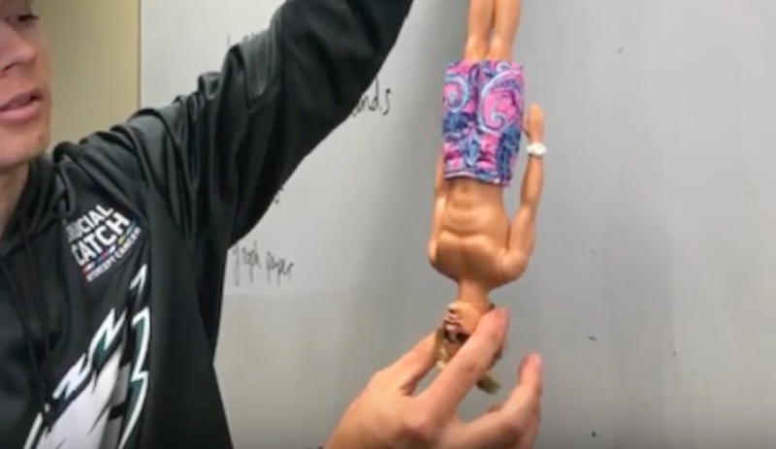
Example: Barbie Bungee
Build an engaging activity around the idea and objectives
“Barbie Bungee”

Slide 18
Example: Barbie Bungee
Students collaborate
to strategize, to collect data, to come up with mathematical equation, to interpret results, to use model to predict and to test the model
to use technology to create a professional report of the project and results

