Slide 1
Region 10 Skills Symposium May 2019 Collaboration Wendy Wiehl, Pharm.D. San Diego City College Alcohol and Other Drug Studies

Slide 2
Collaboration
Small group work on a complex activity is challenging, engaging, stimulating
Requires “positive interdependence” (Johnson, Johnson, Holubec, 2008)

Slide 3
Positive Interdependence
“A situation in which attaining a goal, completing the task, being successful, and earning a good grade require teamwork and sharing knowledge” (edutopia.org)

Slide 4
Collaboration
Small groups allow for minimization of nonparticipation
Allows for assessment of individual as well as group
Shifts role from instructor to coach
Students can discuss concepts and find solutions together

Slide 5
Collaboration
Allows for development of higher level of thinking
Oral communication
Self-management
Leadership skills
(Center for Teaching Innovation)

Slide 6
Collaboration
Promotes student-faculty interaction
Increases student retention, self-esteem, responsibility
Exposure to diverse perspectives
Preparation for real-life social and employment situations
(Center for Teaching Innovation)

Slide 7
Collaboration
Most complex communal, social, workplace problems are solved by groups, not individuals
Variety of skills

Slide 8
Collaboration
Primary benefits of collaborative work are social
Interpersonal communication
Trust
Skill in working with others

Slide 9
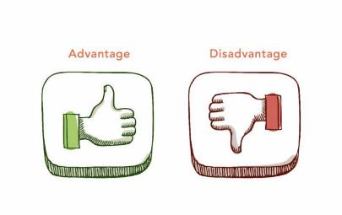
Selection of group members
Teacher assigned vs student selection
Advantages/disadvantages to each

Slide 10
Teacher assigned groups
Based on same skill level or randomly
Randomly
Draw names
Count off
Colored index cards
Random list generator (random.org)

Slide 11
Teacher assigned groups
Advantages
Easy to administer
Breaks-up friendship groups
Allows students to work with others they wouldn’t ordinarily
Seen by students as fair

Slide 12
Teacher assigned groups
Disadvantages
Some students may worry about getting stuck with incompatible members

Slide 13
Student selection of group members
Advantages
Easy to administer
Students like freedom to choose

Slide 14
Student selection of group members
Disadvantages
Can be difficult for students who don’t know anyone in class
Some may see it as unfair

Slide 15
Alcohol and Other Drug Studies
AODS program prepares students for substance use disorder counseling positions
Occupation is part of a multidisciplinary team
Student demographics
Science often seen as intimidating

Slide 16
Candy Neuron assignment
Candy is fun!
Also teaches creative thinking
Assignment follows midterm
Break/reward
Builds on what has been learned
Prepares for final

Slide 17
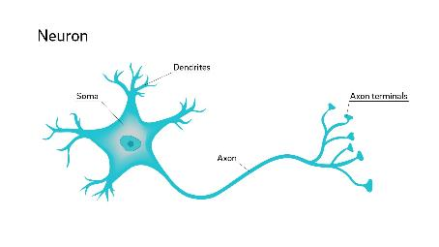
Candy Neuron assignment
Students must create two neurons, pre-synaptic and post-synaptic
Must label parts as well as processes
Must illustrate the mechanism of action of several drugs of abuse

Slide 18
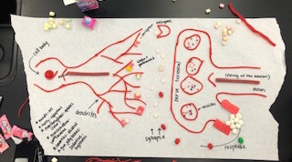

Slide 19
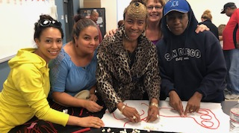

Slide 20
