Slide 1
CoP Discussion
Emerging Themes

Slide 2
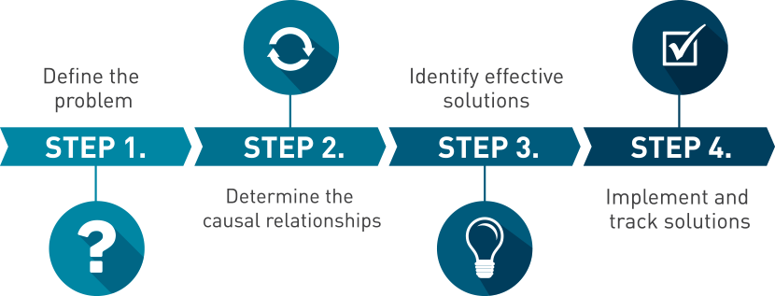
Build A Collaborative Environment:
Sharing Best Practices and Barriers/Challenges on a predetermined topic.

Slide 3
2. Student Success is Our Priority!
Share Student Outcomes, Employment...Tell Their Stories!
Have More Student Voice and Input.

Slide 4
3. Create Networks of Resources and Supports
Regional Communicationa
Collaboration that fosters Career Opportunities for Students

Slide 5
What is Early College Credit?
(Please See Handout)

Slide 6
Build A Collaborative Environment:
Early College Credit: Are you an Expert or a Novice?
1 = Little or No experience with ECC
2 = Intermediate...some practical experience with ECC
3 = Advanced...capable of coaching others on ECC
4 = Expert...able to explain issues with ECC in detail

Slide 7
Early College Credit-Collaborative Activity
On one side of the index card, write 1-2 “BEST PRACTICES” in Early College Credit, and on the other side, write 1-2 “GREATEST CHALLENGES”
Get into a group of four with people who have different colored cards
Select a Reporter & Discuss what you wrote
Share with the whole group

Slide 8
Thank you!!!
And Happy Holidays!

